Slide 1


Welcome to
MBTI® STEP I™
Group Feedback
Copyright 2026 by The Myers-Briggs Company. Myers-Briggs Type Indicator, Myers-Briggs, MBTI, Step I, the MBTI logo, and The Myers-Briggs Company logo are trademarks or registered trademarks of Myers & Briggs Foundation, Inc., in the United States and other countries.
Notes:
Objective: This workshop has been designed to help support practitioners to deliver MBTI group feedback in a virtual setting.
Overview: This deck is accompanied by a short video (https://youtu.be/fYCG969Kgf4) that walks you through the key exercises we have converted to make them suitable for virtual delivery. Similar to a face-to-face group feedback, we estimate that it will take approximately 3 hours and 30 minutes to deliver. We recommend using the “Exploring Your Myers-Briggs Type eWorkbook” to accompany this session, which you can digitally share with participants at the start or prior to the session. If you do not use that resource, be sure to remove mention of it from the slides throughout this deck. The Introduction to Myers-Briggs Type is also a helpful resource that you may choose to purchase to support your delivery.
​Timing (3 hr 30 minutes in total)​​
See the Hidden Detailed Agenda Slide (next) for a closer look at timing.
​Facilitation​​
This workshop is designed for virtual delivery. It uses animated slides and facilitator notes embedded in the slide presentation.​​ Notes indicate which slides animate and what content will be revealed.​​
​
Materials and Technology​​
PPT slides with speaker notes are provided on the slides in this section.​​
Facilitator guide: The PPT has been styled in Notes view and can be printed as a pdf​.​
Exploring Your Myers-Briggs Type eWorkbook and possibly ​The Introduction to Myers-Briggs Type
OPTIONAL: Type and Skills overview video located in the Practitioner Community. Download to your computer to show to participants for smoother delivery (as opposed to streaming the video).​
Technology for virtual delivery and laptop.​​
​
Virtual Delivery Tips ​​
Mute all participants without disabling their mics at the beginning of a session. Allow participants to unmute to participate as needed.​​
Use the meeting controls panel to share documents or other items on your screen​.​
Identify breakout groups ahead of time to make the transitions for activities smoother.
If you are sharing a video, ensure the sound toggle is switched on.​​

Slide 2
HIDDEN SAMPLE AGENDA SLIDE
TOPIC |  | TIME (mins.)
Welcome | Introduction Welcome and intro (7) Guidelines (1) Agenda and purpose (2) | 10
Overview | Why Type? Making It Relevant To You (8) History and Background; Research (4) What Are Preferences (4) Things to Remember; Ethical Use (4) | 20
Preferences | Type Preferences Overview of the preference pairs (5) | 5
E-I | Preferred Work Environment Characteristics overview (5) Overview activity (2) Breakout group discussion (10) Debrief of two groups (5 min per group = 10) Self-estimate (3) How You Use Each Preference (5) | 35
S-N | Tell Me About A Picture Characteristics overview (5) Overview activity; show image (2) Breakout room discussion (5) Debrief of two groups (5 min per group = 10) Self-estimate (3) How You Use Each Preference (5) | 30
TOPIC |  | TIME (mins.)
BREAK | {Optional break to add} | 15
T-F | Recognition and Appreciation Characteristics overview (5) Overview activity (2) Breakout group discussion (10) Debrief of two groups (5 min per group = 10) Self-estimate (3) How You Use Each Preference (5) | 35
J-P | Work or Play First Characteristics overview (5) Overview activity (2) Breakout group discussion (10) Debrief of three groups (3 min per group = 10) Self-estimate (3) How You Use Each Preference (5) | 35
Reported and Best-Fit Type | Review Report Review report (5) Best-fit; why and where pressure (5) Determine best-fit (2) Review type description (3) | 15
 | Action plan | 15
Notes:
This provides an idea of how much time to spend on each topic, but you may update this as needed. Remember to update any changes here on the Agenda slide.

Slide 3
Group Feedback PowerPoint Download
  MBTI® Certified Practitioners are advocates for ethical use. We trust you to use these slides accordingly. By using the slides, you agree to the Guidelines for the Ethical Use of Tests and Questionnaires.
  Please do not pass these slides to unqualified parties, including your workshop participants.
  Please acknowledge The Myers-Briggs Company copyright:
    The copyright and trademark statements on the slides must remain in place.
    In any other materials, state, “Source: The Myers-Briggs Company. Reproduced with permission. Adapted by [your name].”
  You may incorporate your own branding and bespoke content.
Notes:
This hidden slide explains the conditions of The Myers-Briggs Company giving these PowerPoint slides away to you.
As qualified practitioners, you are part of the MBTI community, which stands for high standards and ethical use. We trust you to be MBTI advocates and to use these materials in ethical ways for the purpose of helping others understand more about themselves. Because we are allowing free access to the slides, practitioners have a responsibility to ensure nothing gets added to them that is unethical (e.g., about using the MBTI in selection) or inaccurate. By using these slides, you are signing up to The Myers-Briggs Company’s ethical use policy mentioned in the slide, which is available to view on our website (Legal Notices). This covers: abiding by the recommended admin guidelines; data protection; confidentiality; qualifications; provision of feedback; equal opportunities; and copyright infringement.
Practitioners should not pass these slides on to unqualified parties. This includes participants in a workshop you are running. If these participants ask for the slides, they can be given printouts or a .pps version (i.e., non-editable slides created by using “save as” on the file to create a PowerPoint Show).
The copyright statement should remain on the slide, regardless of what the practitioner does with it. Practitioners should acknowledge The Myers-Briggs Company as the source in any materials they create from our content.
Your own corporate logos or branding can be added. And you can copy and paste the slides into your own corporate template if you wish.

Slide 4

Welcome and Introductions
Please share:
  Your name
  Your job role
  Your location
  Three words or phrases to describe your work style
Notes:
SAY:
Let’s begin with some brief introductions, with each person taking one minute to provide some key information.
As a reminder, my name is __________, and I will be your facilitator today. (Include background on yourself for up to one minute.)
Please share three words or phrases to describe your work style.
Remember, you have one minute.
DO:
Prompt each participant to make their one-minute introduction to provide insight into their work style.
If you have a large group—more than eight people—ask participants to share their three words in the chat box.
Update the activity if conducting this feedback outside of a work context.

Slide 5
Virtual Meeting Guidelines
Limit distractions by putting your phone on silent and closing applications with pop-ups.
Please keep your camera on and actively participate during the session.
Use the chat or “raise hand” feature to ask questions.
Notes:
SAY:
Please practice good virtual meeting etiquette throughout this workshop. Even though we are all likely to have participated in virtual sessions before, let’s review a few etiquette items that will help us interact in a constructive manner.
During this session, please:
Limit distractions by putting your phone on silent and closing applications with pop-ups.
Please keep your cameras on and actively participate during the session!
Ask questions in the chat or raise your hand if you would like to speak.

Slide 6

Agenda
Overview
Preferences
E–I Overview and Activity
S–N Overview and Activity
T–F Overview and Activity
J–P Overview and Activity
Reported & Best-Fit Type
Action Planning
Notes:
DO:
Update the agenda here if any changes were made to the hidden agenda slide.
Review a high-level plan for the day as outlined on the slide.

Slide 7
Purpose
The MBTI® assessment will help you:
Learn about yourself, understanding where you fit in a framework that describes personality differences in positive and constructive ways
Appreciate important differences between people and how different types can work together in a complementary way
Notes:
Review the purpose for today’s feedback session.

Slide 8

Making It Relevant to You
  Self-understanding and individual development
  Communication
  Team building
  Management and leadership
  Coaching
  Organizational development
  Diversity and multicultural training
  Problem-solving and conflict resolution
  Career development and exploration
  Education and learning style
  Relationships
Exploring Your Myers-Briggs® Type Workbook (page 2)
Notes:
DO:
Explain to participants the various ways that understanding their type can be beneficial to them. Ask them to identify why this may be important or of interest to them by entering it into the chat or raising their virtual hand to share verbally with the group.
Provide feedback to participants.
Highlight what they can gain by going through this workshop.
OPTIONAL: Here is a good place to show the Type and Skills Overview video if you choose to use it. The video is approximately three minutes.

Slide 9
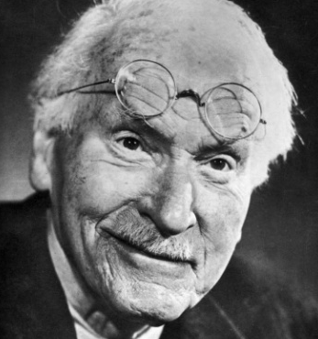
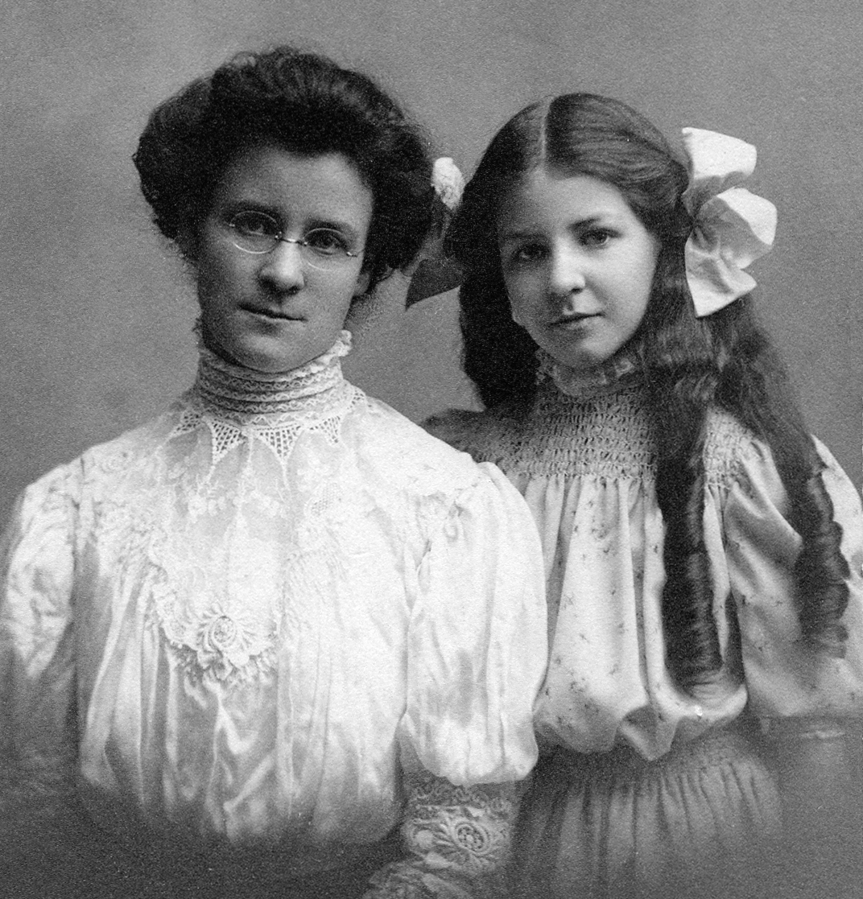
History and Background
The Myers-Briggs Type Indicator® assessment is based on the personality theories of the eminent Swiss psychologist Carl Jung.
The model was developed by two non-psychologists, Katharine Briggs and Isabel Briggs Myers, who wanted to give as many people as possible access to these powerful ideas.
It is one of the few models of personality that describes differences positively.
There are no better or worse types to be; each type has its strengths and possible pitfalls.
Notes:
DO:
Provide a brief background of the assessment using the information on the slide.

Slide 10

Research
  Over 20 years of research went into the MBTI® assessment before it was published.
  There are over 10,000 research papers on the assessment, which provide strong support for its reliability and validity.
  The MBTI assessment continues to be refined and updated. The newest global form includes representative samples from over 20 countries..
  Authors from a wide range of backgrounds have written about the assessment. Hundreds of practical, easy-to-read resources are available.
Notes:
DO:
Briefly review the information on the slide. For additional information, refer to the Global Manual, Table 7.1, page 38.

Slide 11


What Are Preferences?
To illustrate the meaning of preferences,
let’s do an activity.
First, write your name.
Now write your name again using your other hand.
Exploring Your Myers-Briggs® Type Workbook
Notes:
DO:
Ask participants to use their workbook to sign their name on page. This should be on page 4.

Slide 12
What Was the Difference?
Typical responses:
Preferred hand
Feels natural, flowing, and comfortable
Didn’t think about it, just did it
Quick, effortless, and easy
Looks distinctive and recognizable
Nonpreferred hand
Feels unnatural, difficult, and awkward
Requires more concentration
Slow, jerky; takes more effort
Not recognizable at first, but gets easier with practice
Notes:
DO:
Ask participants to share verbally or via the chat how they felt about using their preferred vs. their non-preferred hand.
Review the typical responses, connecting to the feedback participants provided.

Slide 13


Alternative Activities
Arm folding
Clapping
Notes:
DO:
Reveal this slide if you would like to use one of these activities rather than the handwriting. You would not need to use the workbook, but do ask participants to share which arm was on top or which was doing the clapping in the respective activity and debrief the same way as the handwriting activity.

Slide 14
Things to Remember
Preference tells us what you find most energizing and comfortable.
Type cannot determine ability or skill.
There is no such thing as a “right” or “wrong” preference or type.
Everyone can and does use all eight of the preferences.
You are best placed to decide your own type.
Completion of the MBTI® assessment is voluntary.
MBTI® results are confidential. It is your choice to share your results.
Notes:
DO:
Briefly review the information on the slide.

Slide 15
Ethical Use
The MBTI® assessment should only be used for development.
It cannot be used for selection because it tells you nothing about someone’s skills and abilities.
People should only be asked to share their MBTI® type if they feel comfortable doing so. Each individual owns their results.
Notes:
DO:
Briefly review the information on the slide.
This concludes the overview and background of the assessment.

Slide 16
The Four Preference Pairs
E
How do you direct and receive energy?
I
S
How do you take in information?
N
T
How do you decide and come to conclusions?
F
J
How do you approach the outside world?
P
Notes:
THIS SLIDE ANIMATES. CLICK TO REVEAL CONTENT
SAY:​
Let's quickly review how type is based on an individual’s natural preferences in four aspects of personality.​
{CLICK} Extraversion or Introversion (E–I)​ They are opposite ways to direct and receive energy.
{CLICK} Sensing or Intuition (S–N)​ These are opposite ways of taking in information.
{CLICK} Thinking or Feeling (T–F)​ These are opposite ways to decide and come to conclusions. An individual might prefer Thinking (T).
{CLICK} Judging or Perceiving (J–P)​ These are opposite ways of approaching the outside world.
Each person uses and relies on one option more often than the other. One of the two options will come more naturally and feel easier or more comfortable to use.
DO:
Review each preference pair as an overview on this slide and explain that you will take a closer look at each pair, including completing a brief activity.

Slide 17


The Four Preference Pairs: E and I
E
How do you direct and
receive energy?
I
Notes:
DO:
Introduce Extraversion and Introversion by sharing that this is how we direct and receive energy.
Explain that an individual might prefer Extraversion (E). If so, they’ll likely be drawn to the outside world, prefer to talk through problems, learn best by doing or discussing things, have broad interests, and be expressive. Alternatively, they might prefer Introversion (I) and find it more energizing to focus on their inner world, think through problems, learn best by reflecting or through mental practice, focus in depth on a few interests, or be private. Remember, E–I is not about sociability or social confidence. Individuals with preferences for Extraversion or Introversion, in general, have distinctly different preferences.
Then continue to the next slide.

Slide 18


E–I: Characteristics
Tend to act before thinking
Prefer to get into action quickly
Talk things through
Are more expressive when interacting
Gain energy from interaction
Have a breadth of interests
Tend to think before acting
Prefer to spend time on reflection
Think things through
Are more contained when interacting
Gain energy from concentration
Have a depth of interests
Remember, Extraversion–Introversion is not about sociability or social confidence.
Notes:
THIS SLIDE ANIMATES. CLICK TO REVEAL EACH BULLET.
DO:
Explain the characteristics as outlined on the slide. Provide examples as needed to help participants understand these ideas.
Ask if there are any questions before moving on.

Slide 19
E–I: Preferred Work Environment
In groups of Extraversion and Introversion:
Discuss and draw a picture of your ideal work environment.
You’ll have 10 minutes. We’ll then ask you to share your drawing with the wider group.
Notes:
THIS SLIDE ANIMATES.
DO:
Ask participants to indicate which preference resonates more with them at this stage using the chat.
Divide the group into those with a preference for Extraversion and those who prefer Introversion. Form them into groups of between four to six and create break-out rooms. Those still uncertain of their preference should move into one of the groups (whichever they would like to explore for now).
Review what the activity is with participants as outlined on the slide. Ask them to discuss and, using the whiteboard function, draw their ideal work environment. One person in the group will need to share their whiteboard and save the output before the end of the session. You will need to ensure that you can explain to participants how to do this to avoid losing the output. If there is no whiteboard function, ask someone in the group to make a note of the key themes of the discussion as it is happening.
Provide participants with a two-minute warning before closing the breakout rooms.

Slide 20


E–I: Preferred Work Environment
E
I
Enjoy opportunities for interaction
Like plenty of stimulation
Like some background noise
Prefer a busy and lively environment
Need space for concentration
Prefer quiet for reflection
May be irritated by background noise
Prefer a calm, spacious environment
Notes:
DO:
Debrief the activity. Get a summary from one spokesperson in each group. Draw out learning from what is said, and how it is said.
Extraverted preferences may say:
Stimulating, open plan, opportunity for discussion, lots of activity.
Watch for:
During the exercise, there may be lots of talking over each other. If the workshop is face to face, you may see open body language, movement in group, and volume; extraverts tend to dive into action. Each person may pick up a pen and start to draw before an agreed approach is arrived at.
Introverted preferences may say:
Quiet, own office, space to reflect, lots of space and control over the amount of interaction.
Watch for:
During the exercise, there are people speaking one at a time. If the workshop is face to face, you may notice more “contained” body language and a fairly ”still,” quieter group. Introverts often agree to take a few moments to think before discussing the poster, and one person tends to talk at a time. There is discussion and agreement before anything is put to paper.

Slide 21
E–I: Self-Estimate
  From your exploration of Extraversion and Introversion, which seems to fit overall for you? Remember, we all use both—but which is your preference?
Make a note of your self-estimate in the Exploring Your Myers-Briggs® Type Workbook, page 11
Notes:
If someone’s preference is obvious at this stage, they can write their self-estimate on page 10-11 in the workbook. If they are unsure, they can leave it blank and revisit it at the end.
You will notice that we are not revealing the reported type at this stage. We will do that at the end of the four preferences by sending out the reports as part of the best-fit discussions.

Slide 22
E–I: How Do You Use Each Preference?
Where does your preference for Extraversion or Introversion serve you well? When do you find you use the opposite preference?
How could you further develop your use of the preference:
In relation to the purpose you chose earlier?
In relation to communication or team effectiveness?
Make notes of what you learned in Exploring Your Myers-Briggs® Type Workbook, page 12.
Notes:
You can use this slide as a pause for reflection and ask participants to capture their thoughts about how they use this preference and where they might have already identified some areas for development.
This concludes the E-I overview. It is now time to move to the next pair.

Slide 23


The Four Preference Pairs: S and N
S
How do you take
in information?
N
Notes:
DO:
Introduce Sensing and Intuition by sharing that this is how we take in information.
Explain an individual might prefer Sensing (S). If so, they may like to focus on what is real and actual, take a practical approach, see and remember specifics, want information to be accurate and precise, and trust experience. Or they might prefer Intuition (N) and find it more energizing to focus on patterns and meanings, be imaginative, see and remember overall impressions, explore ambiguity and possibilities, and trust inspiration. Remember, Sensing isn’t “sensitive,” and Intuition isn’t “gut feeling.” Individuals with preferences for Sensing or Intuition, in general, also have distinctly different communication styles.
Then continue to the next slide.

Slide 24


S–N: Characteristics
Want to know the facts
Look at the specifics
Adopt a realistic approach
Focus on the here and now
Ensure things work in practice
Collect observations
Seek out new ideas
Look at the bigger picture
Adopt an imaginative approach
Anticipate the future
Ensure things work in theory
Use conceptual frameworks
Remember, Sensing isn’t “sensitive,” and Intuition isn’t “gut feeling.”
Notes:
THIS SLIDE ANIMATES. CLICK TO REVEAL EACH BULLET.
DO:
Explain the characteristics as outlined on the slide. Provide examples as needed to help participants understand these ideas.
Ask if there are any questions before moving on.

Slide 25
S–N: Tell Me About a Picture
Look at the image in silence. Don’t make any notes at this point.
After the image is turned off, you’ll have an opportunity to make notes and discuss the picture with others.
Notes:
DO:
Select a picture to show on the following slide and reveal the slide.
Make sure that everyone has some paper and a pen/pencil on hand. (But ask them not to use these until you indicate for them to do so.)
Ask people to simply look at the picture that you are about to show them on the screen.
Show the picture for approximately 15 seconds before moving to the next slide

Slide 26
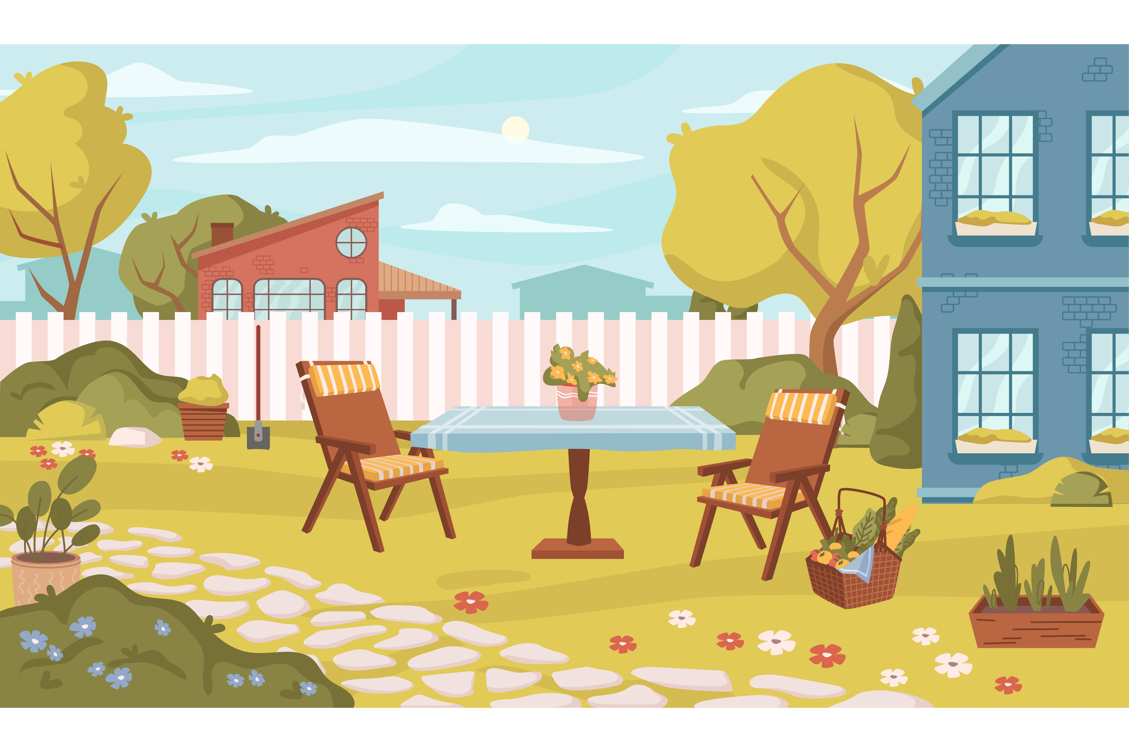
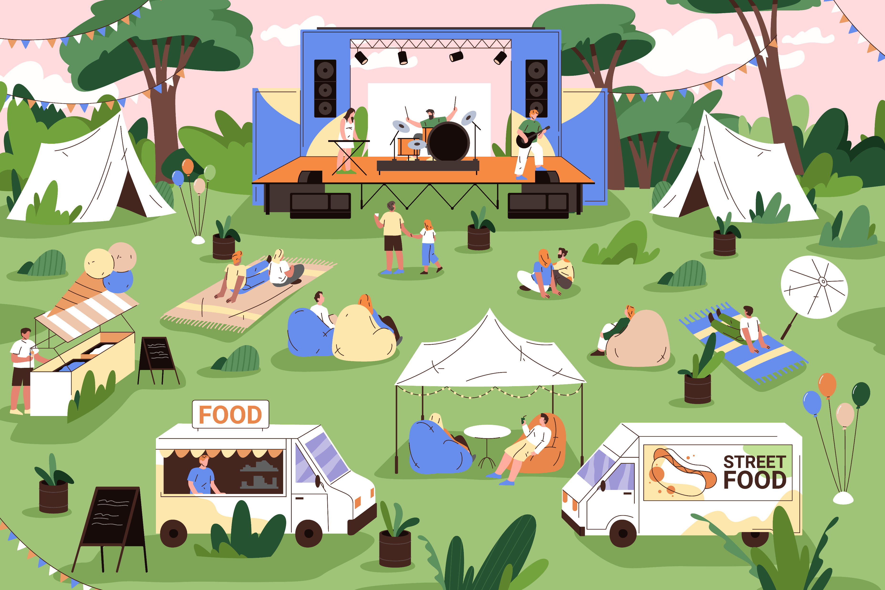
{Select a Picture on this Slide}
Notes:
DO:
You may use any picture to which you have the rights for. Here are two samples that you could use. One should be enlarged to take up most/all of the screen.
Reveal the slide once you have selected the picture you wish to use.
Note that you can ask participants to conduct this exercise again using a second picture. You may want to use a different type of image if conducting it again.
When sharing the picture, only provide 15-20 seconds for them to see it.

Slide 27
S–N: Tell Me About a Picture
On your own, write about the picture.
Now, in your groups, discuss the picture.
Notes:
THIS SLIDE ANIMATES. CLICK TO REVEAL CONTENT.
DO:
Ask each individual to write about the picture. Give them 1-2 minutes. Look to see when the majority of people have lost energy before you continue.
CLICK. Ask them to share what they have written about the picture and to notice differences and similarities. You can prepare groups in advance by mixing up S’s and N’s based on their reported type into small groups of up to six.
Give the groups five minutes in breakout rooms. Then bring them back together and debrief on the next slide.

Slide 28
S–N: Tell Me About a Picture
Will tend to state what is in the picture
Are likely to state the specifics
Will focus on what is realistic
Focus on the here and now
Will go beyond the picture to make associations
Are likely to talk about the “big picture”
Are engaged by imagination
Anticipate the future
Notes:
DO:
Review this slide, then ask the groups to make a note of how their opposite approached the task.
Ask them to do the exercise again but from the opposite point of view of what they think their preference is. If they are unsure, ask them to chose a mode and see what it feels like using either Sensing or Intuition.
Remind them to look at the picture and not to write anything yet. Show another picture for exactly the same amount of time, then get individuals to again write about the picture.
When debriefing this time, you do not need to get people back into the breakout groups. Instead, you can just ask how they found the process. You do not need to hear what they wrote, but it is important to know how they found the exercise. Focus on how comfortable it was and what strategies they used to access their opposite preference.

Slide 29
S–N: Self-Estimate
  From your exploration of Sensing and Intuition, which seems to fit overall for you? Remember, we all use both—but which is your preference?
Make a note of your self-estimate in the Exploring Your Myers-Briggs® Type Workbook, page 17
Notes:
If someone’s preference is obvious at this stage, they can make a note of it on page 17 in the workbook. If they are unsure, then they can leave it blank and revisit it at the end.
Reminder that we are not revealing the reported type at this stage. We will do that at the end of the four preferences by sending out the reports as part of the best-fit discussions rather than feeding in reported type after each preference pair.

Slide 30
S–N: How Do You Use Each Preference?
Where does your preference for Sensing or Intuition serve you well? When do you find you use the opposite preference?
How could you further develop your use of the preference:
In relation to the purpose you chose earlier?
In relation to leadership, change, or your communication style
Make notes of what you learned in Exploring Your Myers-Briggs® Type Workbook, page 18.
Notes:
You can use this slide as a moment to pause for reflection and ask participants to capture their thoughts about how they use this preference and where they might have already identified some areas for development.
This concludes the S-N overview. It is now time to move to the next pair.

Slide 31


The Four Preference Pairs
T
How do you decide and
come to conclusions?
F
Makes decisions by stepping out of the problem to be objective
Makes decisions by stepping into the problem to be compassionate
Notes:
DO
Introduce Thinking and Feeling by sharing that this is how we make decisions and come to conclusions.
Explain an individual might prefer Thinking (T). If so, they’ll likely be analytical, reasonable, guided by objective logic, focused on cause and effect, consistent, and fair. They want everyone to be treated equally. Or they might prefer Feeling (F), in which case they are likely compassionate, guided by personal and social values, focused on the impact on people, empathetic, consistent, and fair. They want everyone to be treated as an individual. Remember, those who prefer Thinking “feel,” and those who prefer Feeling “think.”
Then continue to the next slide.

Slide 32


T–F: Characteristics
Apply logical reasoning
Use cause-and-effect analysis
Seek objective truth
Decide using impersonal criteria
Focus on tasks
Provide a critique
Apply individual values
Understand others’ viewpoints
Seek harmony
Decide by personal circumstances
Focus on relationships
Offer praise
Remember, people who prefer Thinking can “feel,” and people who prefer Feeling can “think.”
Notes:
THIS SLIDE ANIMATES. CLICK TO REVEAL EACH BULLET.
Explain the characteristics as outlined on the slide. Provide examples as needed to help participants understand these ideas.
Ask if there are any questions before moving on.

Slide 33
T–F: Recognition and Appreciation
What do you like to be appreciated or recognized for?
How do you like to be appreciated or recognized? Include when and by whom.
How do you respond if you are not recognized or appreciated in this way?
You will have 10 minutes for your discussion. Be prepared to share your responses with the wider group.
Notes:
DO:
Ask participants to indicate which preference resonates more for them at this stage using the chat. Divide the group into those with a preference for Thinking and those who prefer Feeling. Form them into groups of between four to six and create break-out rooms. Those still uncertain of their preference should move into one of the groups (whichever they would like to explore for now).
Ask groups to prepare responses to each question. Take note of this.
Allow 10 minutes for this, then bring them back into the main session to debrief what is on the next slide.

Slide 34


T–F: Recognition and Appreciation
Like to be recognized for a job well done
Want recognition at the end of a project or when you have excelled
Like recognition from someone qualified to judge your performance
Like to be appreciated for personal contribution and effort
Want to feel valued and appreciated during a project
Like appreciation from those you have made a difference to
Notes:
THIS SLIDE ANIMATES. CLICK TO REVEAL CONTENT.
Ask a spokesperson from each group to share their notes from their discussion. Draw out the learning, making sure that you have highlighted what we would expect to see as the differences between these 2 preferences and then summarize notes below.
{Click to reveal this information} Thinking preferences may say:
Recognized/appreciated for?
Prefer the word “recognized” for a job well done (outcome);
An average job = we feel insulted
Task‐oriented achievements
How recognized/appreciated?
By someone we respect
Not too effusively
Money (or other objective measure of effectiveness)
Being given a larger project
What if not recognized/appreciated?
Angry, annoyed
Distancing (I’ll show them)
Reduced input
It is their problem; they are wrong
Find source of non‐recognition and find out why
{Click to reveal this information} Feeling preferences may say:
Recognized/appreciated for?
Prefer the word “appreciated”
Our personal contribution
Making a difference because of who we are
Helping others practically (Sensing) or in their development (Intuition)
How recognized/appreciated?
Personal and genuine thanks
We like plenty of appreciation
Must be sincere; can easily detect insincerity
Tokens and gestures often appreciated more than money (but more money is nice!)
What if not recognized/appreciated?
Hurt, demotivated, loss of confidence
“What did I do wrong?”
Lack of appreciation can affect Feeling types profoundly

Slide 35
T–F: Self-Estimate
From your exploration of Thinking and Feeling, which seems to fit overall for you? Remember, we all use both—but which is your preference?
Make a note of your self-estimate in the Exploring Your Myers-Briggs® Type Workbook, page 23
Notes:
If someone’s preference is obvious at this stage, they can write it down on page 23 in their workbook. If they are unsure, they can leave it blank and revisit it at the end.
Reminder that we are not revealing the reported type at this stage. We will do that at the end of the four preferences by sending out the reports as part of the best-fit discussions rather than feeding in reported type after each preference pair.

Slide 36
T–F: How Do You Use Each Preference?
Where does your preference for Thinking or Feeling serve you well? When do you find you use the opposite preference?
How could you further develop your use of the preference:
In relation to the purpose you chose earlier?
In relation to your leadership style, conflict, or problem-solving?
Make notes of what you learned in Exploring Your Myers-Briggs® Type Workbook, page 24.
Notes:
DO:
You can use this slide as a moment to pause for reflection. Ask participants to capture their thoughts about how they use this preference and where they might have already identified some areas for development.
This concludes the T–F overview. It is now time to move to the final pair.

Slide 37


The Four Preference Pairs
J
How do you approach
the outside world?
P
Notes:
DO:
Introduce Judging and Perceiving by sharing that this is how we approach the outside world.
Explain an individual might prefer Judging (J). If so, they’ll likely want to have things decided, scheduled, and organized. They likely enjoy decision-making and planning, try to avoid last-minute stress, and tend toward a methodical approach. Or they might prefer Perceiving (P), in which case they likely tend to keep their options open, be spontaneous and flexible, enjoy being able to adapt and change course, find last-minute time pressures energizing, and favor emergent or evolving scenarios. Remember, Judging isn’t “judgmental,” and Perceiving isn’t “perceptive.”
Then continue to the next slide.

Slide 38


J–P: Characteristics
Like to find closure
Make plans
Act in a controlled way
Prefer to act within a structure
Prefer to schedule activities
Like to keep a range of choices available
Remain flexible
Respond to emerging information
Prefer to go with the flow
Prefer to be spontaneous
Remember, Judging isn’t “judgmental,” and Perceiving isn’t “perceptive.”
Notes:
THIS SLIDE ANIMATES. CLICK TO REVEAL EACH BULLET.
Explain the characteristics as outlined on the slide. Provide examples as needed to help participants understand these ideas.
Ask if there are any questions before moving on.

Slide 39
J–P: Work First Vs. Play First Activity
Read the two statements, then place yourself at a position on the line that best represents your typical response.
I have to finish
my work before
I can play
I can play
any time
Notes:
DO:
Ask participants to use the annotate function (if your platform allows it) to place themselves along the line as per the instructions on the slide. If your platform does not allow this, you will need to ask participants to indicate via the chat and create a group for “I have to finish my work,” a group for “I can play anytime,” and a group that would put themselves in the middle.
Put the groups into break-out rooms and ask them to discuss why they placed themselves where they did and how this shows up in what they do.
Give them approximately 10 mins for this discussion. Then bring them back into the main session.

Slide 40

J–P: Work First Vs. Play First
Tend not to feel comfortable “playing” when there is work to be done
Need to mentally “park” the work before you can play
Have clear definition for work and play time
See play as a reward for finishing work
Play without the outstanding work interfering with your enjoyment
Are happy to “play” at work and work at nonconventional times
See work and play as one and the same thing
See life as too short not to take chances to play
Notes:
THIS SLIDE ANIMATES. CLICK TO REVEAL CONTENT.
DO:
Ask for a report back from the “I have to get my work done” group. Ask questions like:
Why did they place themselves there?
How does this attitude to life show itself in their behavior at work and at home?
Do they make a distinction between work and home?
How do they feel if they ignore their preferences and play anyway?
When do they get to play? (They usually say they schedule it in!)
Next, ask the “I can play anytime” group the same questions.
Repeat with the “middle” group for any similarities/differences they are noticing compared to their discussion.
{Click to reveal this information} Judging preferences may say:
They don’t feel comfortable “playing” when there is work to be done.
They need to mentally “park” or reschedule the work before they can play.
They have clear definitions of “work” and “play” time and “categorize” their time.
Play is a reward for finishing work.
If critical of P’s, see “players” as irresponsible. Assume “players” do not get their work done. Feel “dumped upon” by players.
If envious of P’s, they may wish they could work more spontaneously (without feeling guilt).
{Click to reveal this information} Perceiving types may say:
They can stop and play at any opportunity without the outstanding work interfering with their enjoyment.
See work and play as one and the same.
They are happy to ”play” at work and “work” at non‐conventional times.
Life is too short not to take chances to play.
If critical of J’s, they may see “workers” as uptight and in need of relaxation. Feel disapproved of by “workers” and limited by them. Think, “Thank goodness” the workers are there to do it!
If envious of J’s, they may wish they could play more evenly or feel they “should” do so

Slide 41
J–P: Self-Estimate
From your exploration of Judging and Perceiving, which seems to fit overall for you?
Make a note of your self-estimate in the Exploring Your Myers-Briggs® Type Workbook, page 29
Notes:
If someone’s preference is obvious at this stage, they can write it on page 29 in their workbook. If they are unsure, they can leave it blank

Slide 42
J–P: How Do You Use Each Preference?
Where does your preference for Judging or Perceiving serve
you well? When do you find you use the opposite preference?
How could you further develop your use of the preference:
In relation to the purpose you chose earlier?
In relation to managing conflict, your leadership style, or organizational culture?
Make notes of what you learned in Exploring Your Myers-Briggs® Type Workbook, page 30.
Notes:
DO:
Use this slide as a pause for reflection and ask participants to capture their thoughts about how they use this preference and where they might have already identified some areas for development.
This concludes the J-P overview and covering all four of the process pairs.

Slide 43

MBTI®
Reported Type

Slide 44
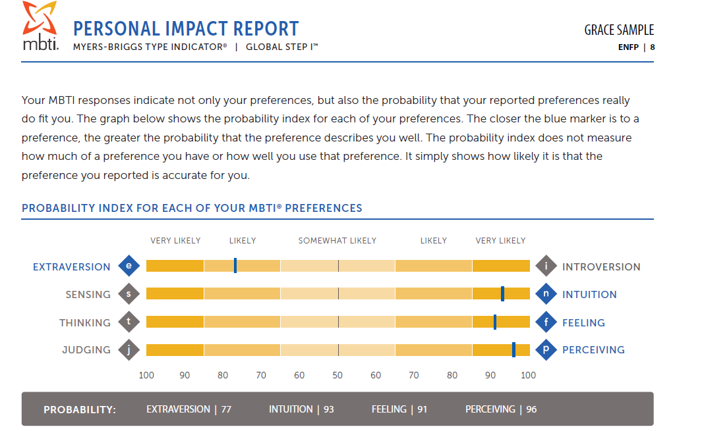
Preference Probability Results
Preference results show the probability with which you reported a preference based on your answers to the MBTI® assessment. This tells us how confident we can be that the sorting is correct.
They do not show your skill in using the preference, or how much or how little you use it.
Notes:
DO:
Review the information on the slide and direct participants to review their scores in their report.

Slide 45

MBTI®
Best-Fit Type

Slide 46

Pulling Together Your Best-Fit Type
This is the four-letter MBTI® type you think fits you best. It’s typically referred to as your “best-fit-type.”
If you are unsure about any preference pair, consider whether there are demands on you to operate differently from your natural preference.
Don’t worry if you are still unsure—you have time to reflect before you decide.

Slide 47
Why Might Your Reported Type Not Fit?
You may be attracted to elements of both opposites in one or more preference pairs.
You may be using some facets of both preferences. Your Step II™ results may clarify this and help you decide on a preference.
External influences may be affecting your use of your preferences.
You will have many opportunities to further explore your type and arrive at a best-fit type.
It is okay if you later discover that a different type fits you better.
Notes:
DO:
Review with participants the reasons there may be a difference between their reported type and best-fit type.

Slide 48
Where Does This Pressure Come From?
Pressure from your work to do things that don’t match your preferences.
Pressure from an organization to behave in certain ways.
Pressure from society, such as gender stereotypes.
Pressure you felt growing up.
Notes:
DO:
Review the information on the slide by providing the additional information below and sharing examples help form connections.
SAY:
Pressure from your work to do things that don’t match your preferences. (For example, someone with a preference for Introversion who works as a trainer may learn to use behaviors related to Extraversion to get their work done.)
Pressure from an organization to behave in certain ways. (For example, in some organizations, people with a Perceiving preference may feel that they “should” plan better and be more organized than they prefer to be.
Pressure from society, such as gender stereotypes. (For example, a man with a Feeling preference may feel pressure to behave in a more Thinking way, or a woman with a Thinking preference may feel pressure to behave in a more Feeling way.)
Pressure you felt growing up. (For example, someone with an Introversion preference who grows up in an extraverted family may feel it’s not “right” or “good” to prefer Introversion.)

Slide 49

What Is Your Best-Fit Type?
Take a look at the short descriptions of your possible alternatives on page 9.
Which one resonates with you the most? Remember, you know yourself best!
Notes:
DO:
Ask participants to reflect on the various activities and information along with what they read in their report and workbook.
Continue to the next slide to have participants review information about their types and what they think may fit them. (Or review that information here and hide the following slide.)

Slide 50
Introduction to Myers-Briggs® Type
  Once you are confident about your best-fit type, read the full, two-page description to learn more.
Notes:
DO:
Have participants review the workbook pages on their type. They can look at the Table of Contents to locate their type more quickly/easily.
Ask for people to share any insight(s) or reactions in the chat.

Slide 51
Action Planning
After reading about your type, use the following questions to consider your learning and development:
How can you make best use of your strengths?
How might others see you?
Are there any areas you would like to develop?
What concrete actions can you take moving forward?
Notes:
DO:
Ask participants to reflect on these questions and update how they will share that information based on how you will conclude this workshop.

