Slide 1


Welcome to
MBTI® STEP II™
Group Feedback
Copyright 2026 by The Myers-Briggs Company. Myers-Briggs Type Indicator, Myers-Briggs, MBTI, Step I, the MBTI logo, and The Myers-Briggs Company logo are trademarks or registered trademarks of Myers & Briggs Foundation, Inc., in the United States and other countries.
Notes:
Objective: This workshop has been designed to help support practitioners to deliver MBTI group feedback in a virtual setting.
Overview:. Similar to a face-to-face group feedback, we estimate that it will take approximately 3 hours and 30 minutes to deliver. We recommend using the “Understanding Your MBTI® Step II™ Results” booklet to accompany this session, which you can digitally share with participants at the start of or prior to the session. If you do not use that resource, be sure to remove mention of it from the slides throughout this deck.
​Timing (3.5 hours in total)​​
See the Hidden Detailed Agenda Slide (next) for a closer look at timing.
​Facilitation​​
This workshop is designed for virtual delivery. It uses animated slides and facilitator notes embedded in the slide presentation.​​ Notes indicate which slides animate and what content will be revealed.​​
Materials and Technology​​
PPT slides with speaker notes are provided on the slides in this section.​​
Facilitator guide: The PPT has been styled in Notes view and can be printed as a pdf​.​
Understanding Your MBTI® Step II™ Results.
Technology for virtual delivery and laptop.​​
​
Virtual Delivery Tips ​​
Mute all participants without disabling their mics at the beginning of a session. Allow participants to unmute to participate as needed.​​
Use the meeting controls panel to share documents or other items on your screen​.​
Identify breakout groups ahead of time to make the transitions for activities smoother.
If you are sharing a video, ensure the sound toggle is switched on.​​

Slide 2
HIDDEN SAMPLE AGENDA SLIDE
TOPIC |  | TIME (mins.)
Welcome | Introduction Welcome and intro (7) Guidelines (1) Agenda and purpose (2) | 10
Overview | Step II™ Assessment Understanding MBTI® Step II™ assessment (4) Benefits of Step II assessment(4) Relationship between Step I and Step II (2) | 10
Facets | Step II Facet Scores Overview of the facet results (1) In-Preference (3) Out-of-Preference (3) Midzone (3) | 10
E-I | Step II Facets Facet overview (3) Initiating–Receiving Activity (10) E–I Facets Explained (10) Team discussion (10) Team Poster (2) | 35
S-N | Step II Facets Facet overview (3) Realistic–Imaginative Activity (10) S–N Facets Explained (10) Team discussion (10) Team poster (2) | 35
TOPIC |  | TIME (mins.)
BREAK | {Optional break to add} | 15
T-F | Step II Facets Facet overview (3) Logical–Empathetic Activity (10) T–F Facets Explained (10) Team discussion10) Team Poster (2) | 35
J-P | Step II Facets Facet overview (3) Early Starting–Pressure Prompted Activity (10) E–I Facets Explained (10) Team discussion10) Team Poster (2) | 35
Closing | Action Plan | 15
Notes:
This provides an idea of how much time to spend on each topic. You may update this schedule as needed. Remember to update any changes here on the Agenda slide.

Slide 3
Group Feedback PowerPoint Download
  MBTI® Certified Practitioners are advocates for ethical use. We trust you to use these slides accordingly. By using the slides, you agree to the Guidelines for the Ethical Use of Tests and Questionnaires.
  Please do not pass these slides to unqualified parties, including your workshop participants.
  Please acknowledge The Myers-Briggs Company copyright:
    The copyright and trademark statements on the slides must remain in place.
    In any other materials, state, “Source: The Myers-Briggs Company. Reproduced with permission. Adapted by [your name].”
  You may incorporate your own branding and bespoke content.
Notes:
This hidden slide explains the conditions of The Myers-Briggs Company providing you with these PowerPoint slides.
As qualified practitioners, you are part of the MBTI community, which stands for high standards and ethical use. We trust you to be MBTI advocates and to use these materials in ethical ways for the purpose of helping others understand more about themselves. Because we are allowing free access to the slides, practitioners have a responsibility to ensure nothing gets added to them that is unethical (e.g., about using the MBTI in selection) or inaccurate. By using these slides, you are signing up to The Myers-Briggs Company’s ethical use policy mentioned in the slide, which is available to view on our website (Legal Notices). This covers: abiding by the recommended admin guidelines; data protection; confidentiality; qualifications; provision of feedback; equal opportunities; and copyright infringement.
Practitioners should not pass these slides on to unqualified parties. This includes participants in a workshop you are running. If these participants ask for the slides, they can be given printouts or a .pps version (i.e., non-editable slides created by using “Save As” on the file to create a PowerPoint Show).
The copyright statement should remain on the slide, regardless of what the practitioner does with it. Practitioners should acknowledge The Myers-Briggs Company as the source in any materials they create from our content.
Your own corporate logos or branding can be added. And you can copy and paste the slides into your own corporate template if you wish.

Slide 4

Welcome and Introductions
Please share:
  Your name
  Your job role
  Your location
  Three words or phrases to describe your work style
Notes:
SAY:
Let’s begin with some brief introductions, with each person taking one minute to provide some key information about themselves.
As a reminder, my name is __________, and I will be your facilitator today. (Include background information on yourself for up to one minute.)
Please share three words or phrases to describe your work style.
Remember, you have one minute.
DO:
Prompt each participant to make their one-minute introduction to provide insight into their work style.
If you have a large group—more than eight people—ask participants to share their three words in the chat box.
Update the activity if conducting this feedback outside of a work context.

Slide 5
Virtual Meeting Guidelines
Limit distractions by putting your phone on silent and closing applications with pop-ups.
Please keep your camera on and actively participate during the session.
Use the chat or “raise hand” feature to ask questions.
Notes:
SAY:
Please practice good virtual meeting etiquette throughout this workshop. Even though we are all likely to have participated in virtual sessions before, let’s review a few etiquette items that will help us interact in a constructive manner.
During this session, please:
Limit distractions by putting your phone on silent and closing applications with pop-ups.
Keep your cameras on and actively participate during the session!
Use the chat or “raise hand” feature to ask questions

Slide 6

Agenda
MBTI® Step II™ Assessment
Overview
Step II™ facets
Facet learning tasks
Q&A
Action Plan
What are you most curious to learn about your facet results?
Notes:
DO:
Update the agenda here if any changes were made to the hidden agenda slide.
Review a high-level plan for the day as outlined on the slide.

Slide 7
Learning Objective
Outline the benefits of the MBTI® Step II™ assessment.
​​​​​Clearly understand the relationship between the MBTI® Step I™ and Step II™ assessments.
​Explore how the 20 facets of the Step II™ framework explain the diversity within the expression of your type.
Notes:
DO:
Review the purpose for today’s feedback session.
SAY:
Today, we’re going to go over the MBTI Step II and look at your own Step II results.

Slide 8
ISTJ
ISFJ
INFJ
INTJ
ISTP
ISFP
ENTJ
ENFJ
INFP
ESFJ
ESTJ
INTP
ESTP
ESFP
ENFP
ENTP
Notes:
Team Type:
What do you want to share with your team about your MBTI® Step II™ type?
What do you want to ask each other?
What are you curious to learn about this team?

Slide 9

A Greater Understanding Using the MBTI® Step II™ Assessment
The Step II™ assessment helps you explore the next level of type by identifying the ways you use particular facets of the Step I™ preferences.
Each of your four MBTI preferences is complex and includes many distinct but related facets. These facets form the basis of the Step II assessment.
The Step Il assessment adds to our information about personality type by identifying five facets for each of the four preference pairs of the MBTI type system, for a total of 20 facets.
Understanding Your MBTI® Step II™ Results
Notes:
DO:
Explain to participants the various ways that understanding their Step II results can be beneficial to them. Ask them to identify why this may be important or of interest to them by entering it into the chat or raising their virtual hand to share verbally with the group.
Provide feedback to participants.
Highlight what they can gain by going through this workshop.
(Optional, only if using resources)
SAY: The Understanding Your MBTI® Step II™ Results booklet is a helpful guide to have available as we go through our feedback session today. You can also use this after the session as you explore your Step II report in more detail.
We’ll also refer to the MBTI® Step II™ Feedback Cards throughout today’s session and look at how you can use these for both one-on-one and group feedback. Note that you may choose to purchase these and use them, particularly for an in-person feedback session.

Slide 10

MBTI® Step II™ Assessment
Overview
Notes:
DO:
Send out Step II Reports.

Slide 11
MBTI® Global Step II™ Assessment
  Provides your four-letter Step I™ type, plus information about the attributes that underlie type preference for a deeper exploration of personality preferences
  Explores 20 facets of personality type—five facets for each Step I preference pair
  Reveals the unique expression of your four-letter type
  Examines expressed behavior in contrast with Step I™, which looks at your preference
  There are no right or wrong, better or worse profiles.
Notes:
SAY:
Just as each Step I preference pair is made up of two opposite preferences, each facet in the Step II framework has two opposite poles. Step II facets are some components of the Step I preference pairs, but they don’t capture every aspect of the four pairs. Patterns of facets within a preference pair may reflect ways in which less preferred aspects of personality are expressed. Facet results do not have to match the underlying Step I preference—we’ll look at this in a moment when we explore Step II scoring.

Slide 12
Benefits of the MBTI® Step II™ Assessment
  Clarify or address questions or doubts you may have about your four basic MBTI® type preferences
  Explain and explore differences between people with the same preferences or four-letter type
  Affirm and deepen your understanding of how you uniquely experience your personality type.
Notes:
SAY:
People don’t tend to have all the characteristics associated with their Step I preferences or their best-fit MBTI type. In other words, we are more interesting than our four preferences. Some people might be unclear or unsure of their Step I preferences. Their Step II facet results can help explain or clarify their underlying preferences.
It’s also helpful to remember that the Step I assessment doesn’t report differences within each type.
If you prefer Extraversion, for example, that doesn’t mean you are exactly like others who also prefer Extraversion.
If you have ESTP preferences, you’re not identical to all other people who have ESTP preferences. The Step II framework can help respondents explore these differences.
When people explore their Step II results, they often say it affirms how they experience their personality type.

Slide 13
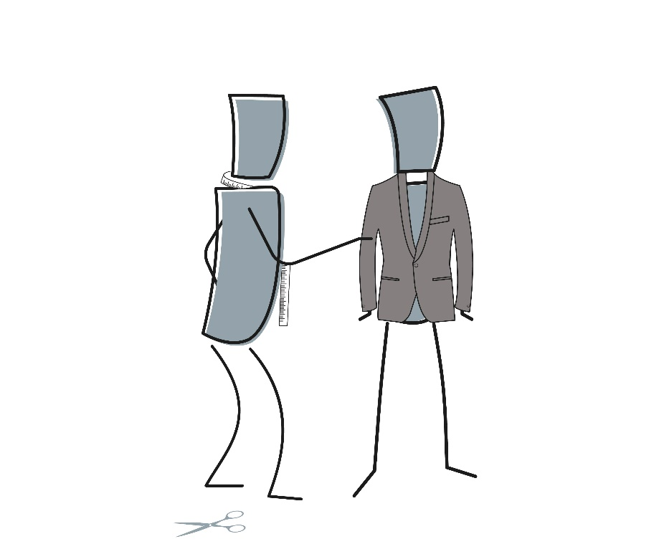
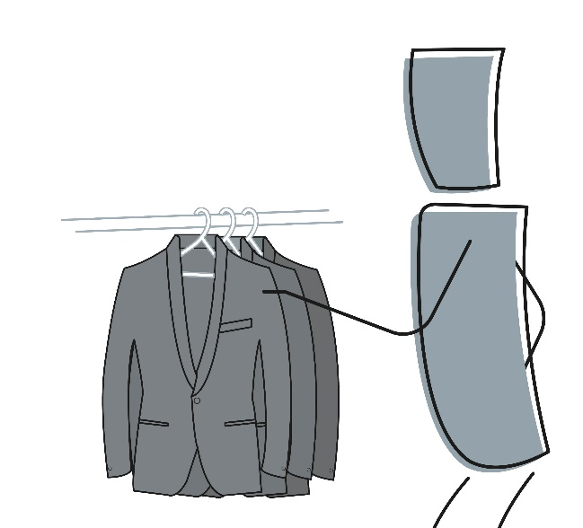
Relationship Between Step I™ and Step II™
Step I™ Assessment
Step II™ Assessment
Notes:
Say:
Step I (Off the rack): Your Step I profile is like a jacket bought off the rack at a department store. It generally fits and is fine for everyday wear, but it may not fit you perfectly.
Step II (Tailored to fit): Your Step II profile is like a jacket that has been tailored specifically to fit you. In general, your Step II profile provides a more accurate description of how you express your type.
It’s important to note that you need to choose a jacket from the available range (one of the 16 Myers-Briggs types identified in the Step I framework) before you can make alterations (Step II facets). You can’t adapt a jacket if you don’t have one!
In the MBTI framework, this means that respondents need to receive feedback on their Step I results before they can start to explore their Step II facets.

Slide 14
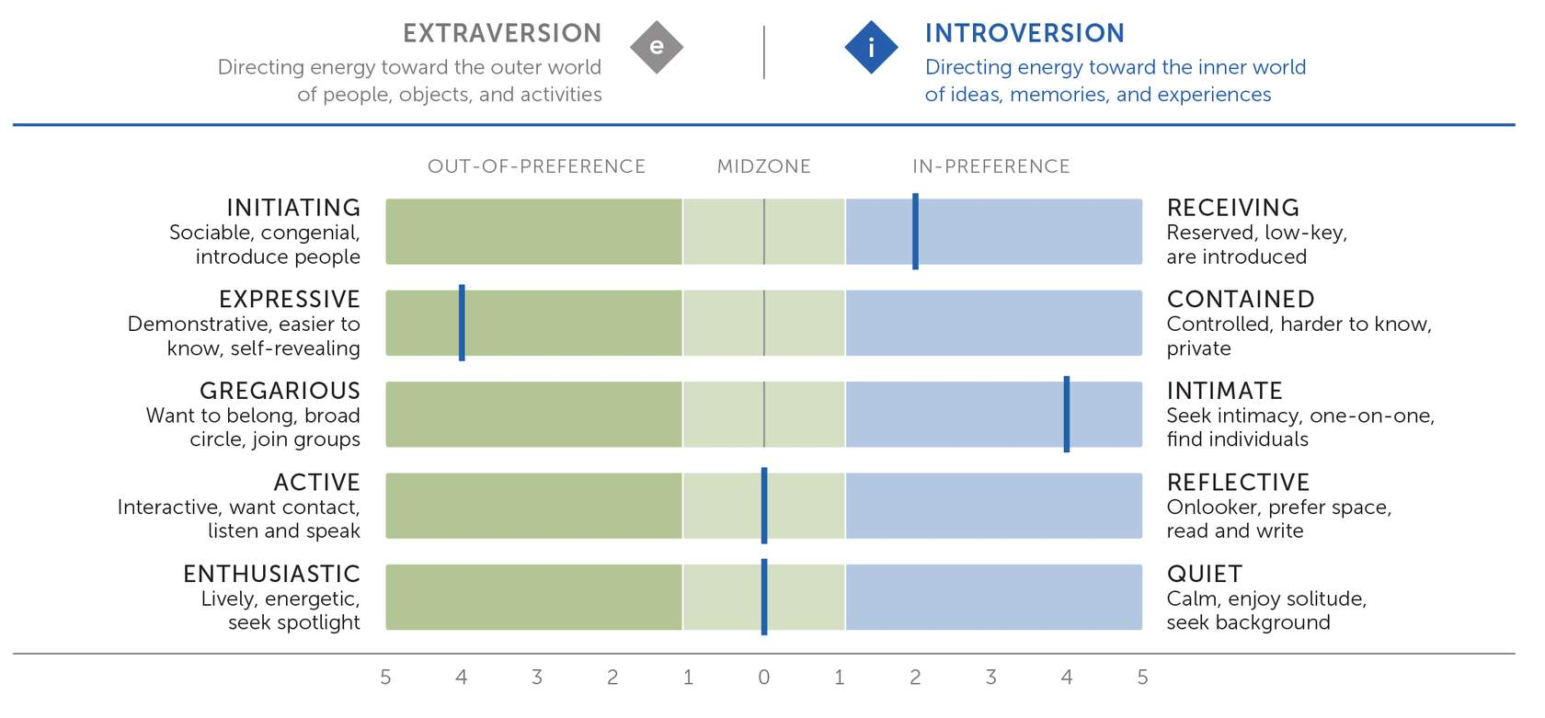
Step II™ In-Preference Results
in-preference
Notes:
In-Preference result:
A facet score of 2 to 5 on the same side as your Step I™ preference.
A Step II™ result in keeping with the underlying Step I preference
Does not indicate that you never use the opposite pole
In-Preference results typically occur more often than Midzone or Out-of-Preference results. It’s still important to see if you agree with the In-Preference facet description.

Slide 15
Step II™ Out-of-Preference Results
out-of-preference
Notes:
Out-of-Preference result:
A facet score of 2 to 5 on the side opposite the underlying preference
May demonstrate how you appear to be different from others who share your four-letter type
Less common than In-Preference and Midzone results
Likely to be long-standing adaptations to your environment and life experiences
Can often be verified and “explained” by you

Slide 16
Step II™ Midzone Results
midzone
Notes:
Midzone result:
A facet score of 0 or 1 on either side.
Possible reasons for a Midzone result include:
Habitual use of both poles
Ambivalence about which pole to use
Situational use of each facet pole

Slide 17
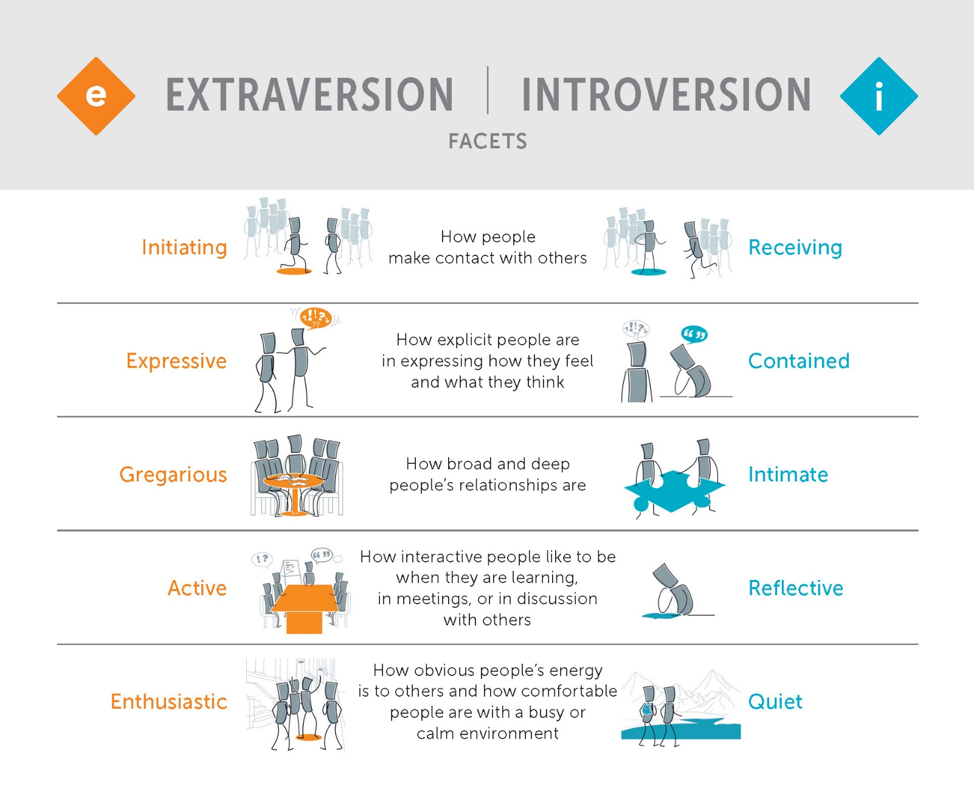
MBTI® Step II™ Interpretive Report (page 5)
Notes:
(Optional, if using Feedback Card Set resource)
Say:
You have this feedback card in your Step II set. All the illustrations you’ll see in this section are on the cards.

Slide 18
Initiating–Receiving Activity
  You are going to a networking event after work. You don’t know anyone there except the organizer who invited you.
  What do you think or feel about the event?
  What strategies do you have?
  What are you likely to do when you are there?
  When do you leave?
  You’ll have 8 minutes for your discussion.
  Be prepared to share your answers.
Midzone
Initiating
Receiving
Notes:
DO:
Set up groups of participants with Initiating, Receiving, and Midzone results in advance (three groups).
Label the breakout groups and let participants choose their breakout based on their results.
Split groups larger than six into two or more groups. Have multiple groups for each category if necessary.
Here are some points to listen for during debrief:
People who report Initiating tend to listen to and remember details of other people’s lives to help them “work the crowd” more effectively. Those who report Receiving are more comfortable when they find an individual or small group to connect with.
People with Receiving results will often have strategies worked out in advance, including an exit strategy. People who report Initiating may question why anyone would need a strategy at all.
People who report in the Midzone may say that their approach depends. If they do, remember to ask what their behavior depends on.

Slide 19
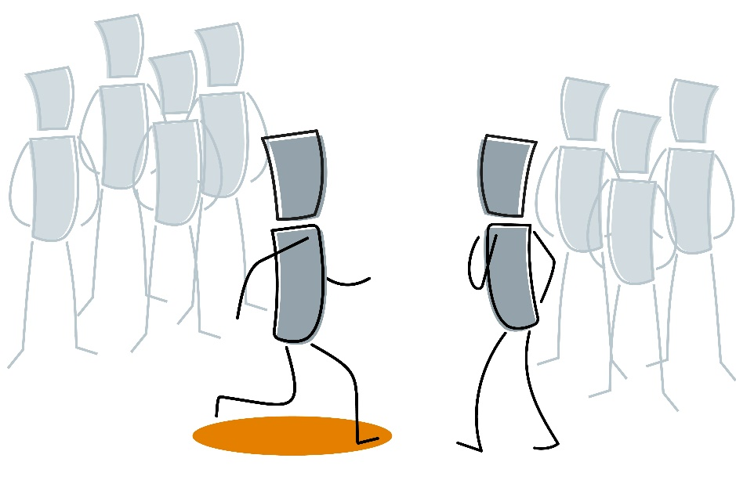
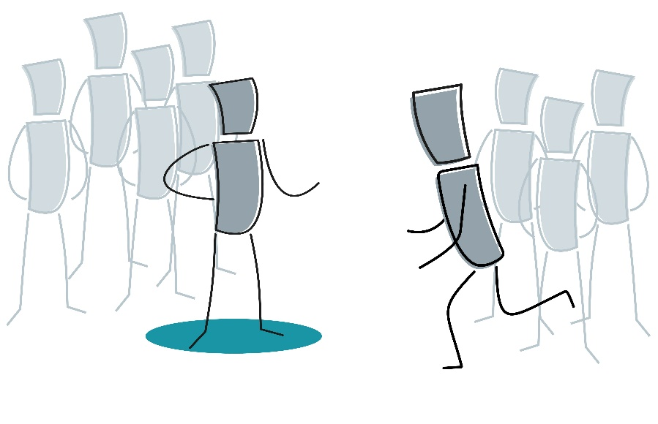
Initiating–Receiving
How you prefer to connect with others
Notes:
SAY:
Are you usually comfortable introducing yourself and talking to people you don’t know well (Initiating)?
OR
Do you usually prefer to stay with people you know well in social situations and let others introduce you to new people (Receiving)?

Slide 20
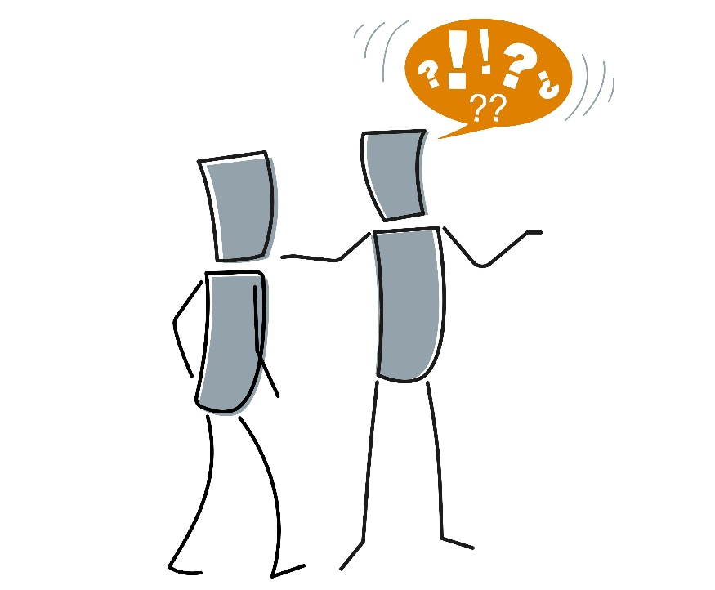
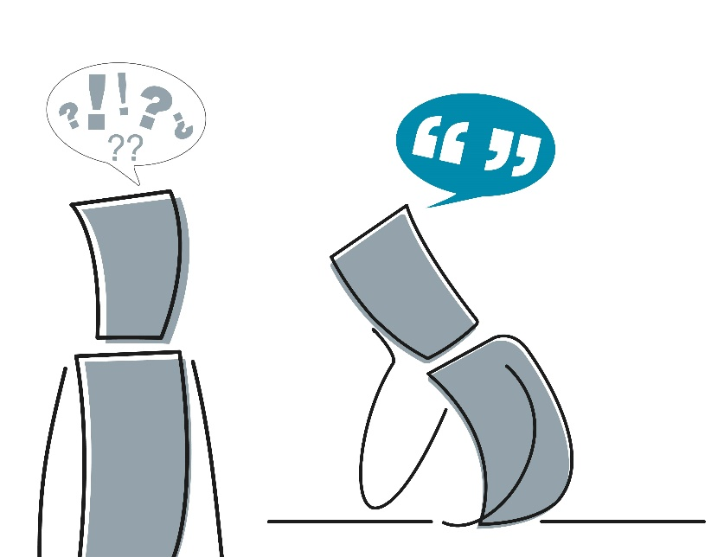
Expressive–Contained
How explicit you are in expressing how you feel and what you think
Notes:
SAY:
Do you tend to think out loud, readily sharing your thoughts, feelings, interests, and opinions with others (Expressive)?
OR
Are you usually selective in the information you share about yourself, revealing only what’s relevant to the situation (Contained)?

Slide 21


Gregarious–Intimate
How broad and deep your relationships are
Notes:
SAY:
Do you tend to enjoy meeting new people, joining groups, and working in teams? Would you describe yourself as sociable, with lots of friends and acquaintances (Gregarious)?
OR
Do you tend to value intimacy, differentiate between your friends and acquaintances, and focus your attention on long-standing friendships you’ve developed over time (Intimate)?

Slide 22
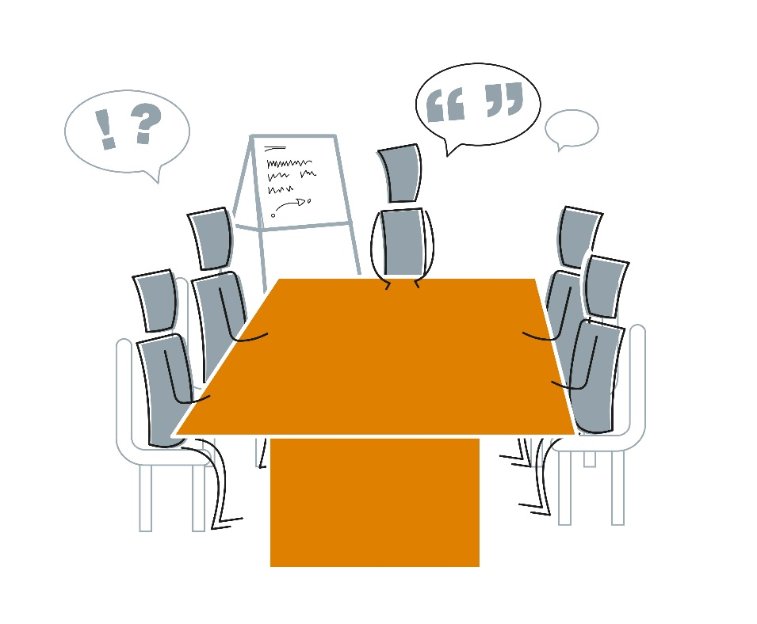
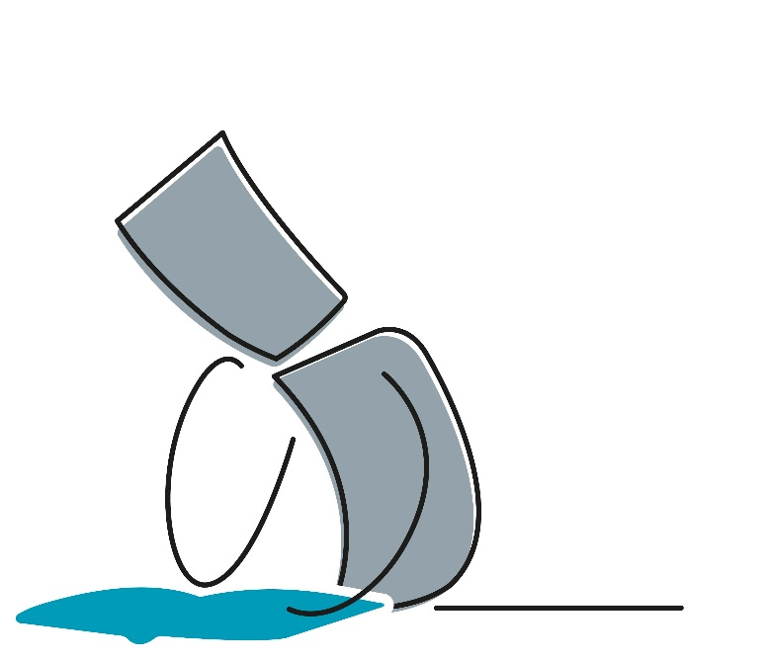
Active–Reflective
How interactive you like to be when you're learning, in meetings, or in discussion with others
Notes:
DO:
Do you usually learn best by interacting with your environment and discussing things with others (Active)?
OR
Do you usually learn best by reading, writing, and reflecting on a topic before you discuss it with someone else (Reflective)?

Slide 23
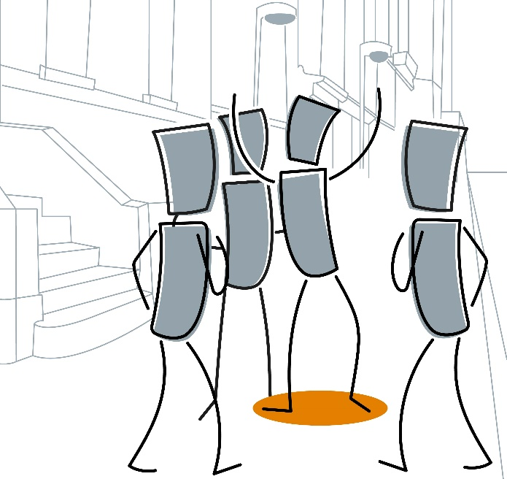
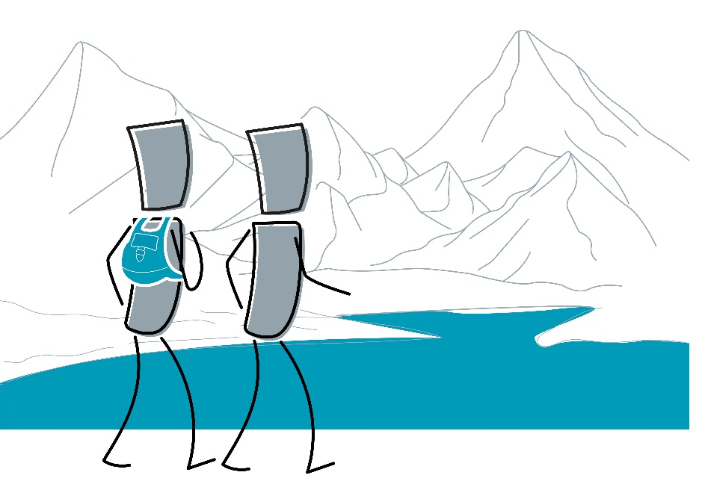
Enthusiastic–Quiet
How obvious your energy is to others and how comfortable you tend to be in busy or calm environments
Notes:
SAY:
Do you like to be where the action is and enjoy being the center of attention (Enthusiastic)?
OR
Do you prefer a calm, tranquil environment and tend to avoid drawing attention to yourself (Quiet)?
DO:
Ask participants to comment on any of their own facet results for this preference pair.

Slide 24
MBTI® Step II™ and Teams
  As a group, discuss your facet results on the next slide:
  What do these results mean for this team?
  What do you want to share regarding your own results?
  What do you want to ask others about their results?

Slide 25
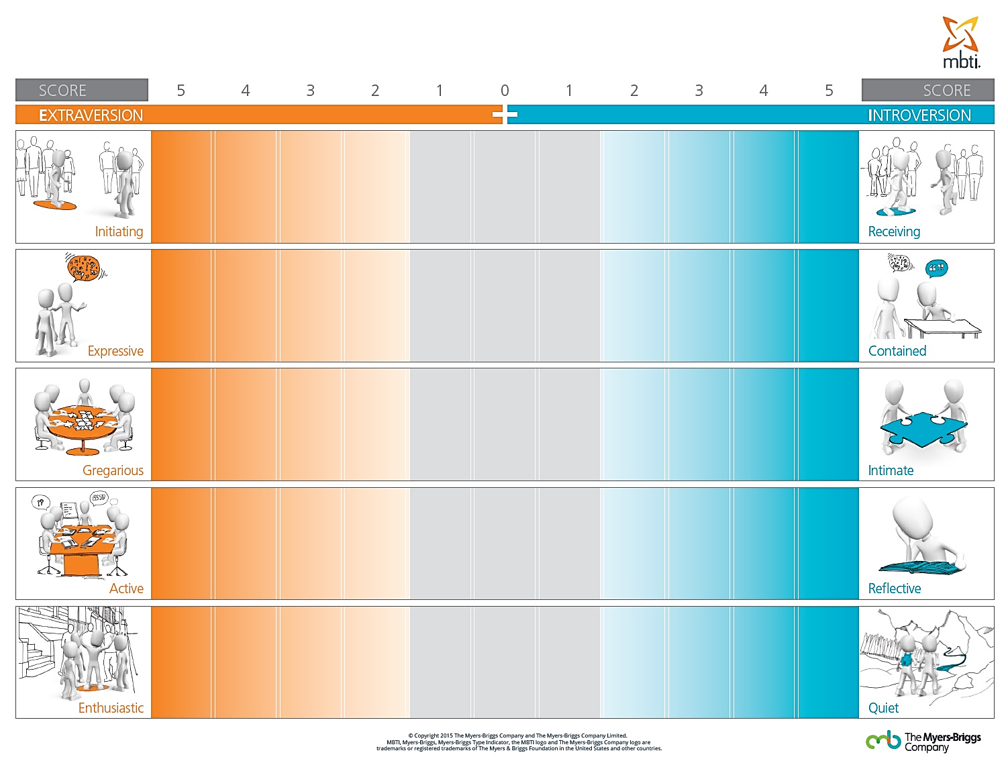
E–I Facets Team Poster
MB
MB
MB*
Notes:
Note: Replace “MB” initials with those of the current team based on their score. The “*” symbol represents an Out-of-Preference facet result.

Slide 26
E–I Facets Team Poster
Score | 5 | 4 | 3 | 2 | 1 | 0 | 1 | 2 | 3 | 4 | 5 | Score
Initiating |  |  |  |  |  |  |  |  |  |  |  | Receiving
Expressive |  |  |  |  |  |  |  |  |  |  |  | Contained
Gregarious |  |  |  |  |  |  |  |  |  |  |  | Intimate
Active |  |  |  |  |  |  |  |  |  |  |  | Reflective
Enthusiastic |  |  |  |  |  |  |  |  |  |  |  | Quiet
Extraversion
Introversion
MB
MB
MB*
Notes:
Note: Replace “MB” initials with those of the current team based on their score. The “*” symbol represents an Out-of-Preference facet result.

Slide 27
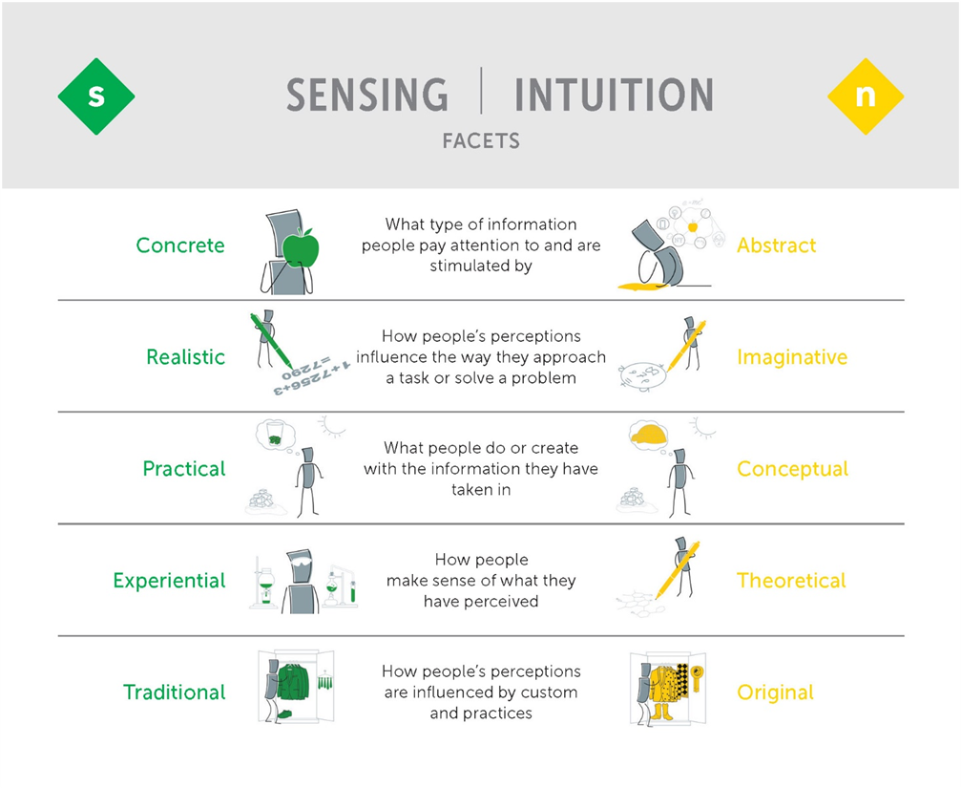
MBTI® Step II™ Interpretive Report (page 6)
Notes:
(Optional, if using Feedback Card Set resource)
Say:
You have this feedback card in your Step II set. All the illustrations you’ll see in this section are on the cards.

Slide 28
Realistic–Imaginative Activity
  There are pictures of objects on the next slide.
  Take a photo or screenshot of the slide so you can refer to it in your breakout group.
  In your group, discuss what you would use the items for.
  You’ll have seven minutes for your discussion.
  Be prepared to share your answers.
Midzone
Realistic
Imaginative
Notes:
DO:
Set up breakout groups by labeling them Realistic, Imaginative, and Midzone and letting participants choose their breakout based on their results.
People with Midzone results often ask for more clarity. For example, they might ask if all the objects are included. Avoid any attempts to clarify the activity. Instead, simply repeat the question, “What would you use these items for?”

Slide 29







What Would You Use These Items For?
Notes:
Listen for:
The language participants use (i.e., “these are...” or “these could be…”)
Differences between participants’ initial responses and what they go on to discuss
Whether participants include all the objects, whether they add any objects that aren’t there, or if they use each object separately (Realistic) or attempt to use them collectively (Imaginative)
For in-person facilitation, put a group of objects on a table in the center of the room. Then ask participants to line up next to the table based on their Realistic–Imaginative results.

Slide 30

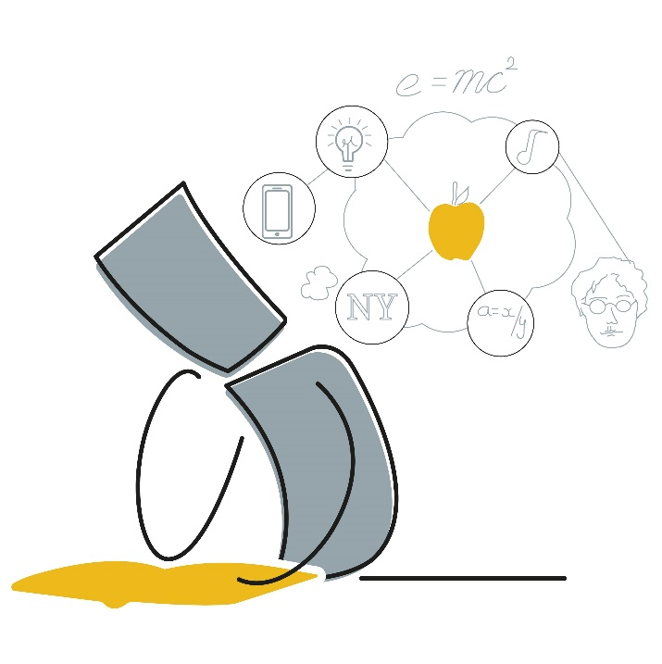
Concrete–Abstract
The type of information you tend to pay attention to and find stimulating
Notes:
SAY:
Do you prefer to stay grounded in facts—usually working with, and talking about, things that are real and tangible (Concrete)?
OR
Are you more comfortable looking for patterns and connections, exploring areas of ambiguity and expressing yourself through metaphors and analogies (Abstract)?

Slide 31
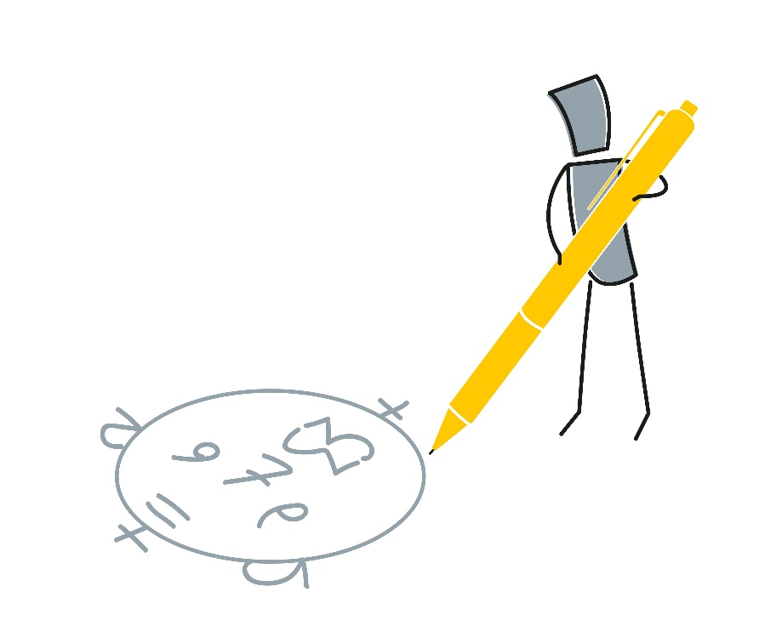
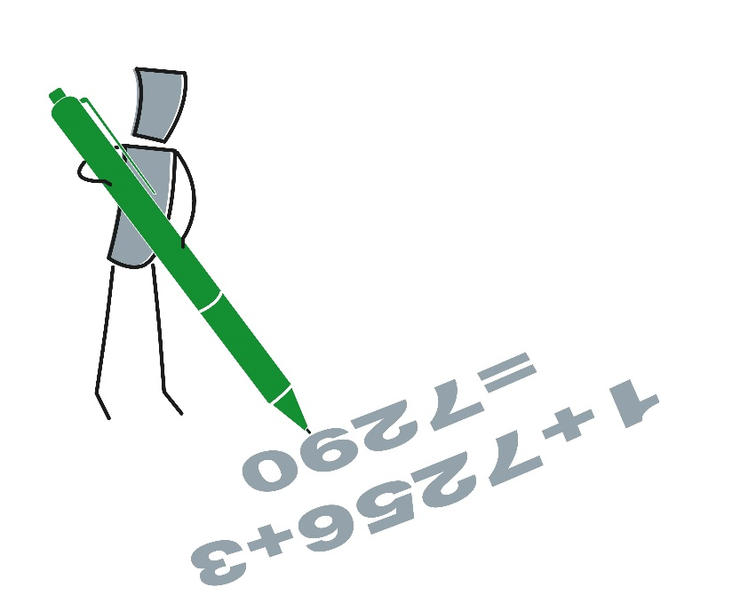
Realistic–Imaginative
How you use information from your perceptions to approach a task or problem
Notes:
SAY:
Do you tend to look for efficient, commonsense solutions to problems and ways to approach tasks (Realistic)?
OR
Do you tend to look for different ways to solve problems and approach tasks—preferably something that hasn’t been thought of before (Imaginative)?

Slide 32
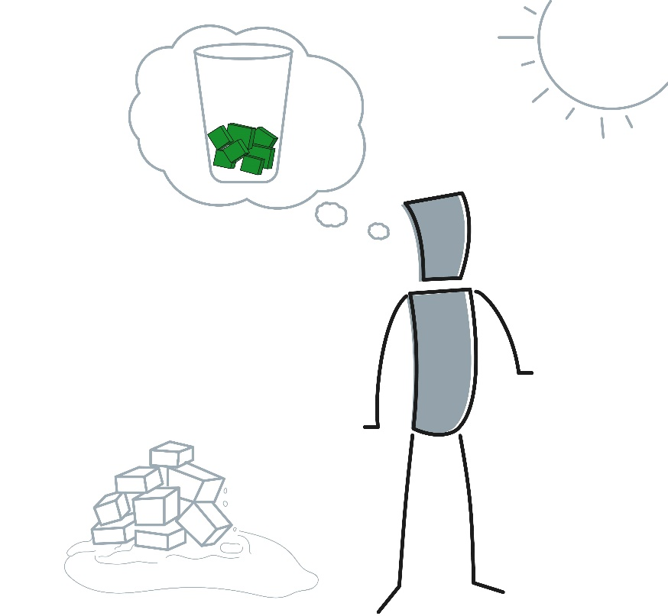
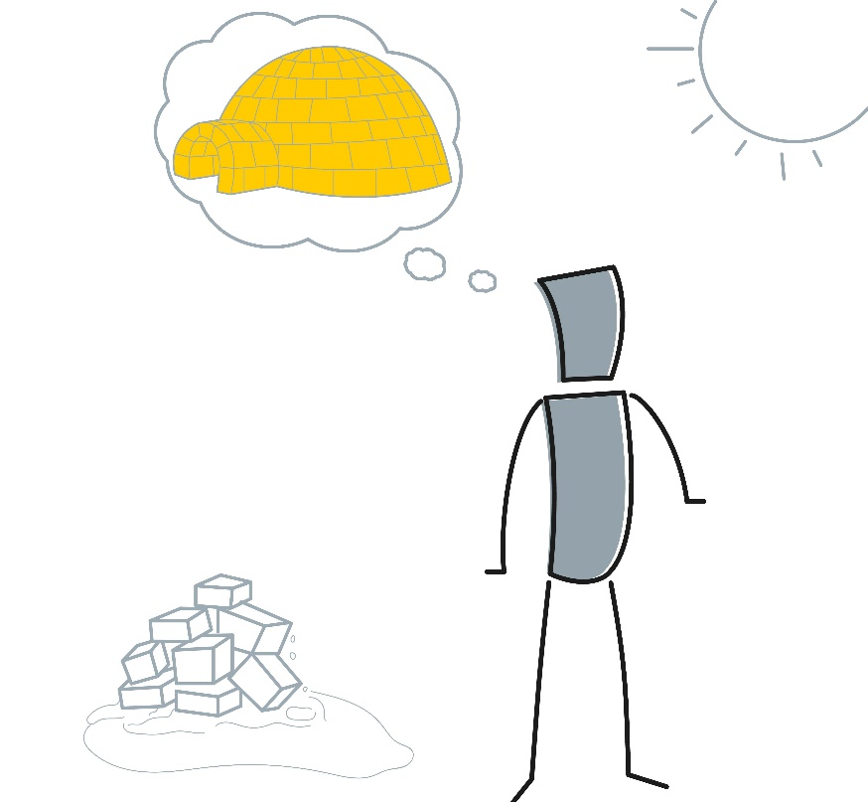
Practical–Conceptual
What you do or create with the information you take in
Notes:
SAY:
Do you generally like to focus on what’s relevant to today and apply information you take in right away (Practical)?
OR
Do you usually focus on how things might be in the future and enjoy learning something new even if you can’t see an immediate use for it (Conceptual)?

Slide 33
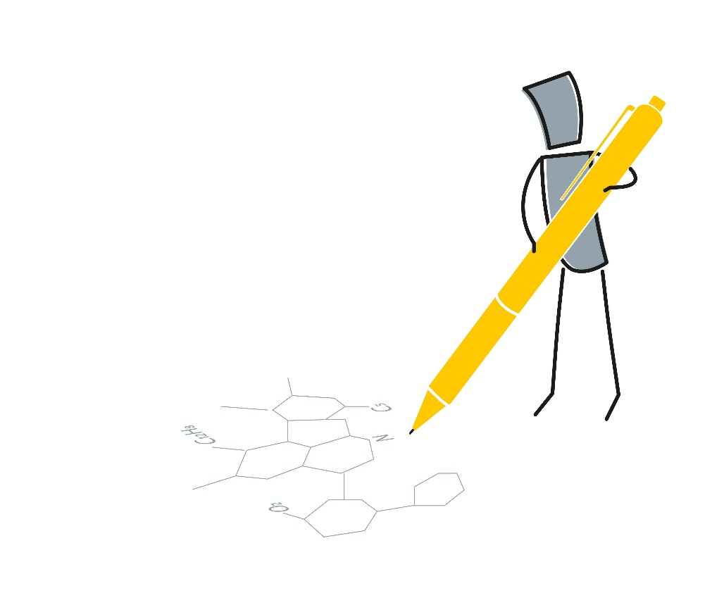
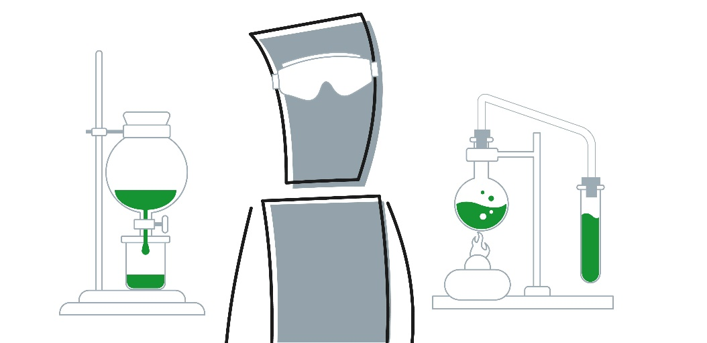
Experiential–Theoretical
How you make sense of what you’ve perceived
Notes:
SAY:
Do you usually rely on firsthand experience, trying things out to see if they’re useful (Experiential)?
OR
Do you tend to trust theories and rely on theoretical concepts to help you understand and explain things (Theoretical)?

Slide 34
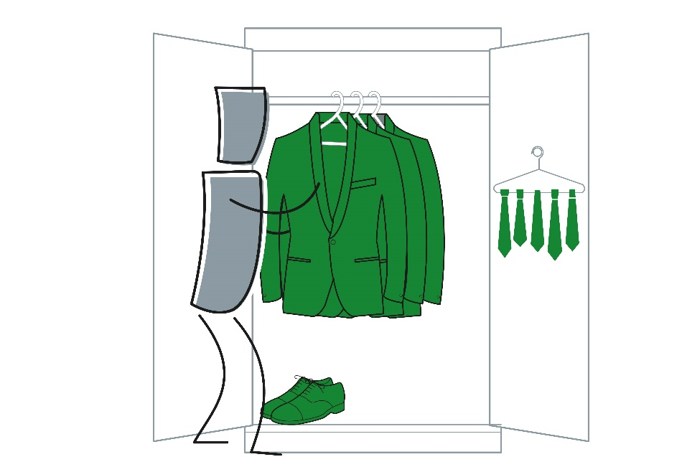
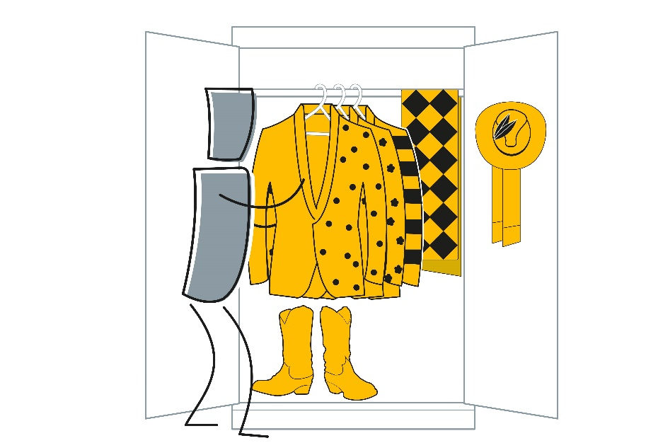
Traditional–Original
How you tend to approach traditions
Notes:
SAY:
Do you usually like to follow established customs, honoring traditions to provide continuity (Traditional)?
OR
Do you have a drive to be different, often finding unique or unconventional approaches and new ways to celebrate traditions (Original)?
DO:
Ask participants to comment on any of their own facet results for this preference pair.

Slide 35
MBTI® Step II™ and Teams
  As a group, discuss your facet results on the next slide:
  What do these results mean for this team?
  What do you want to share regarding your own results?
  What do you want to ask others about their results?

Slide 36
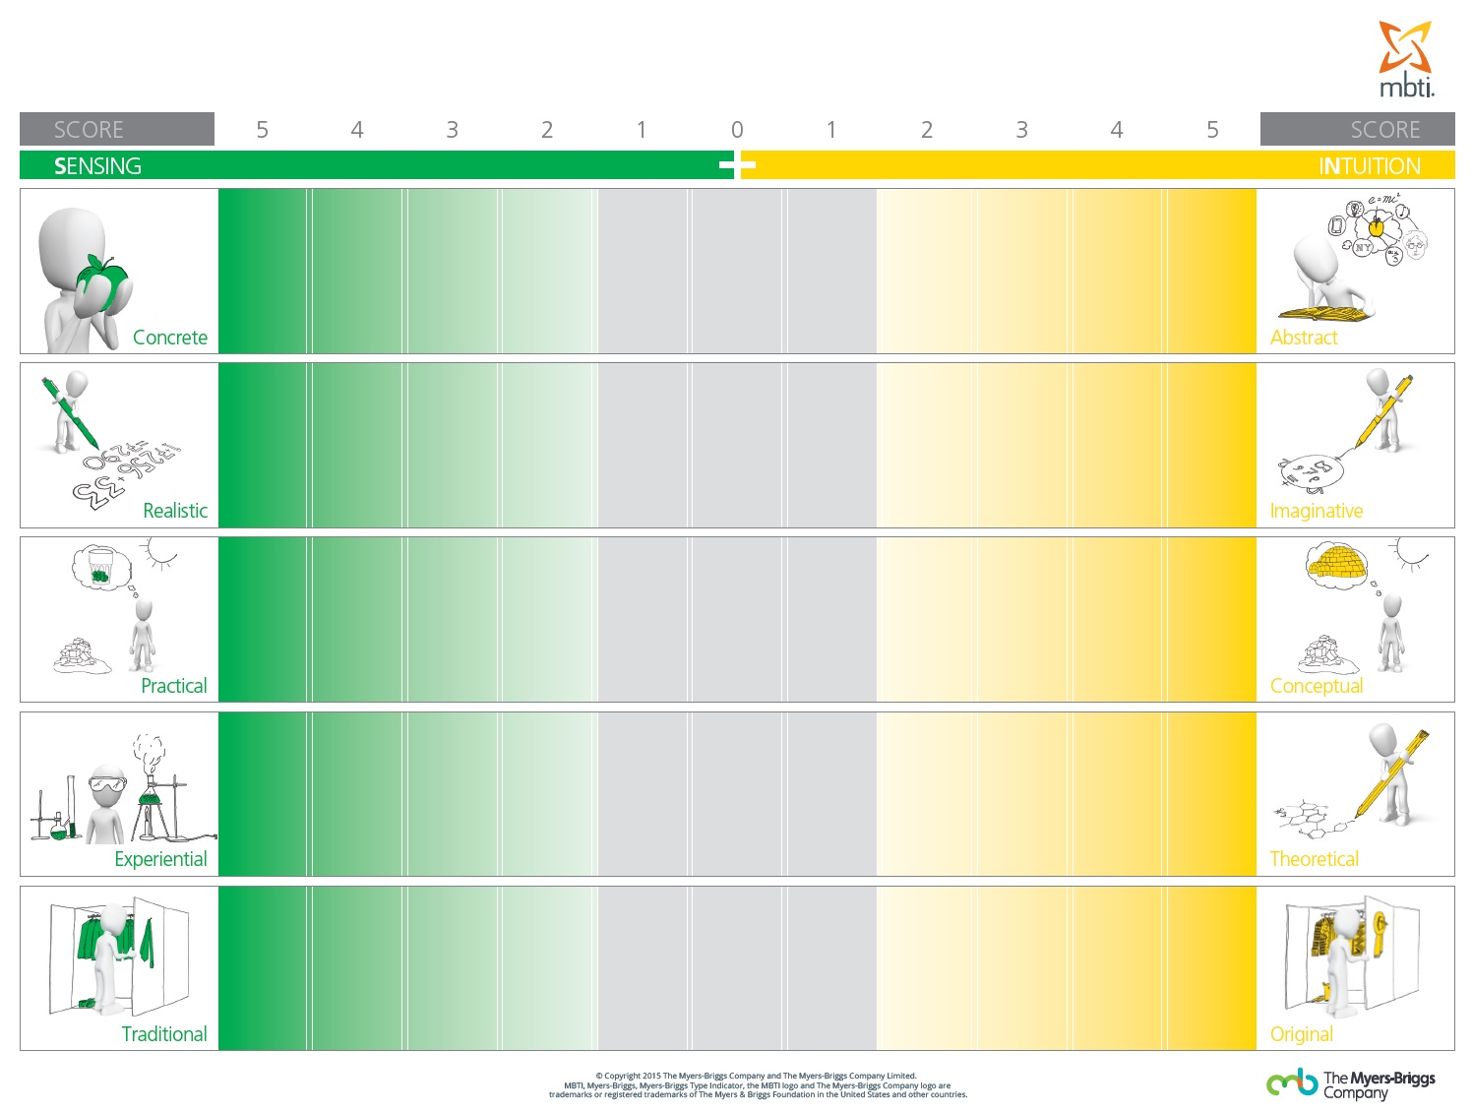
S-N Facets Team Poster
HB
KA
KG
NZ
NL
CB
HB
KA
KG
NZ
NL
CB
HB
KA
CB
NZ
NL
KG
HB
CB
KG
NZ
NL
KA
HB
KG
CB
NZ
NL
KA
Notes:
Note: Replace initials with those of the current team. Also, an * represents an Out-of-Preference facet result.

Slide 37
S–N Facets Team Poster
Score | 5 | 4 | 3 | 2 | 1 | 0 | 1 | 2 | 3 | 4 | 5 | Score
Concrete |  |  |  |  |  |  |  |  |  |  |  | Abstract
Realistic |  |  |  |  |  |  |  |  |  |  |  | Imaginative
Practical |  |  |  |  |  |  |  |  |  |  |  | Conceptual
Experiential |  |  |  |  |  |  |  |  |  |  |  | Theoretical
Traditional |  |  |  |  |  |  |  |  |  |  |  | Original
Sensing
Intuition
MB
MB
MB*
Notes:
Note: Replace “MB” initials with those of the current team based on their score. The “*” symbol represents an Out-of-Preference facet result.

Slide 38
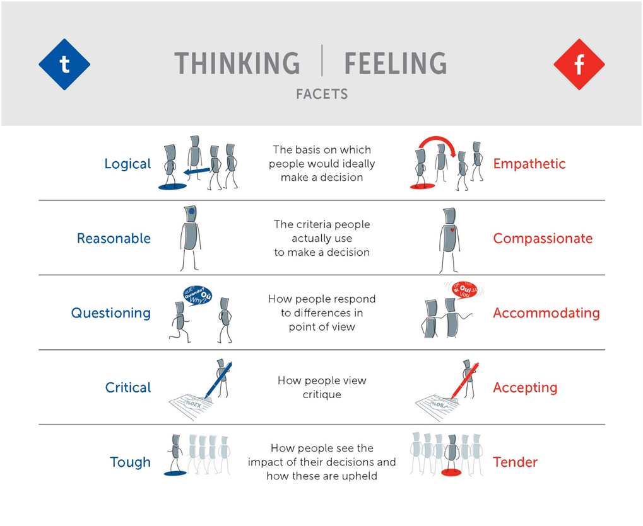
MBTI® Step II™ Interpretive Report (page 7)
Notes:
(Optional, if using Feedback Card Set resource)
Say:
You have this feedback card in your Step II set. All the illustrations you’ll see in this section are on the cards.

Slide 39
Logical–Empathetic Activity
  You are on a conference committee tasked with finding a keynote speaker. You recommended your friend because of their expertise, and they are selected as the speaker.
  Ahead of the conference, you receive feedback that your friend is a poor speaker.
  How will you handle the situation?
  What are the important factors for you?
  What is your final decision? Who will implement it and how?
  You’ll have 10 minutes for your discussion.
  Be prepared to share your answers.
Midzone
Logical
Empathetic
Notes:
DO:
Set up groups of participants with Logical, Empathetic, and Midzone results in advance (three groups). Split up groups larger than six and have multiple groups for each category if required.

Slide 40
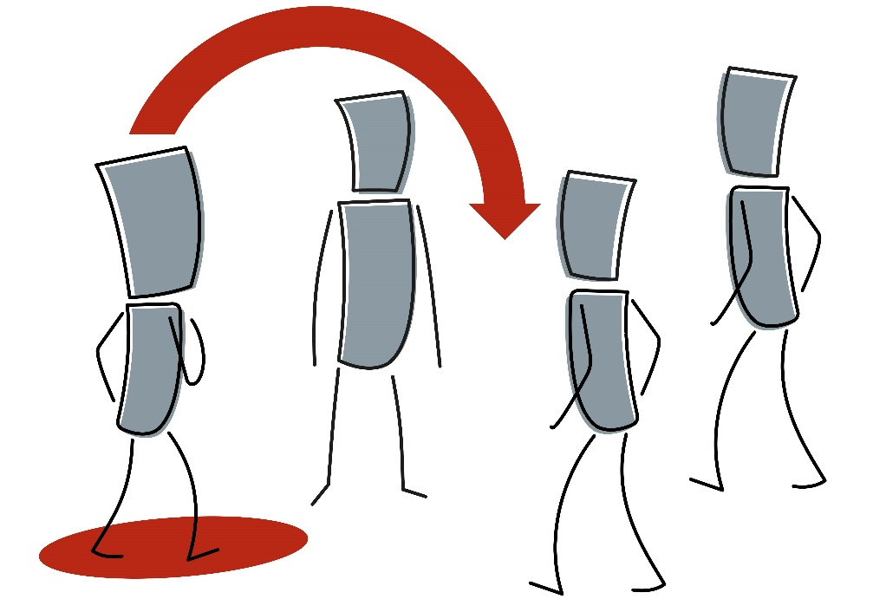
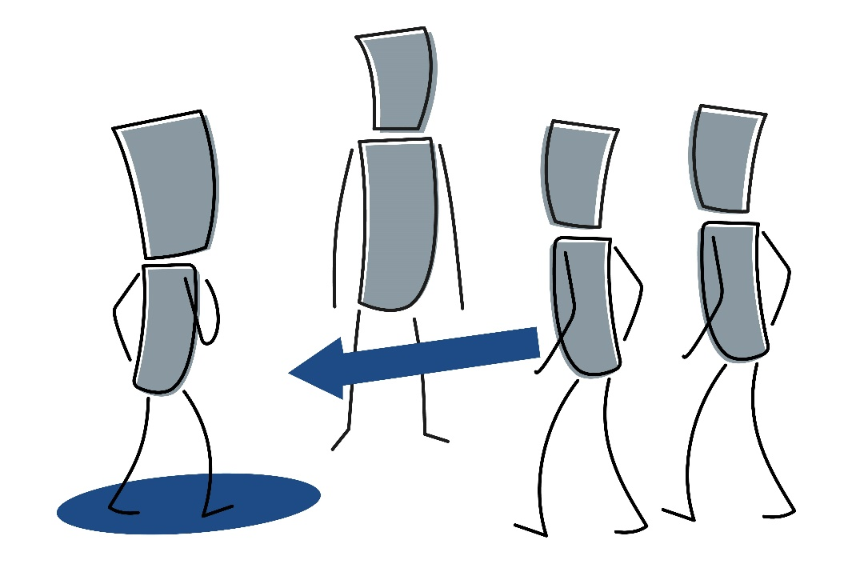
Logical–Empathetic
The criteria you use to make decisions
Notes:
SAY:
Do you usually favor an objective approach to decision-making—trusting, gathering, and analyzing data to develop a plan of action based on the pros and cons of possible solutions (Logical)?
OR
Do you tend to value a focus on the effects a decision might have on the people involved—considering the values and relationships that could be affected (Empathetic)?

Slide 41
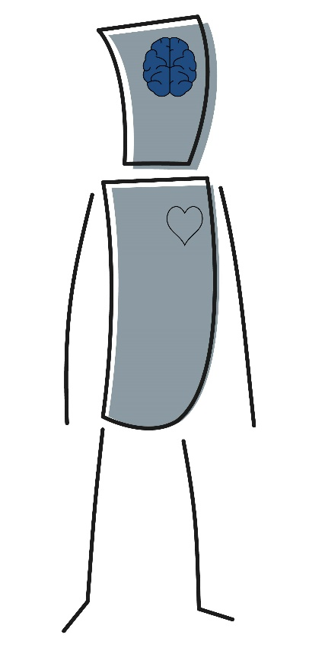
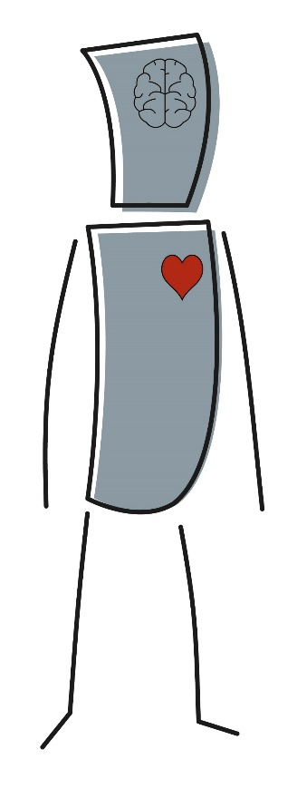
Reasonable–Compassionate
How you measure the impact of your decisions
Notes:
SAY:
Do you tend to make decisions objectively, using logic to treat people fairly and consistently (Reasonable)?
OR
Do you tend to make decisions based on how you and others feel about a situation, accounting for the circumstances of the people involved (Compassionate)?

Slide 42
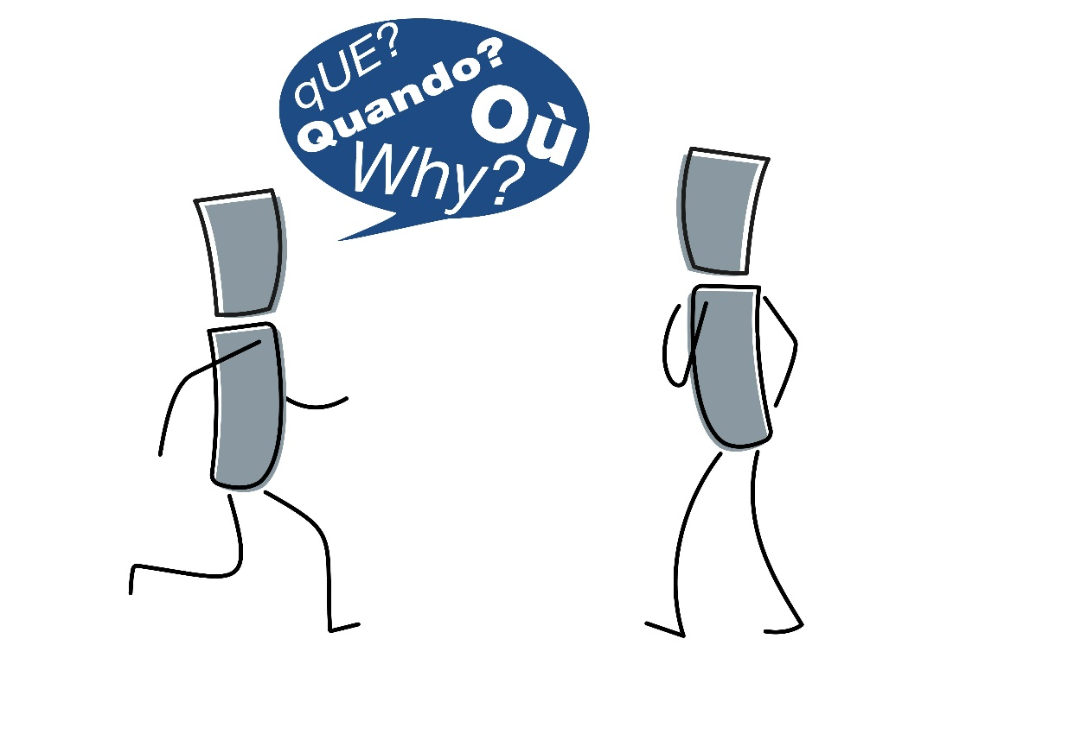
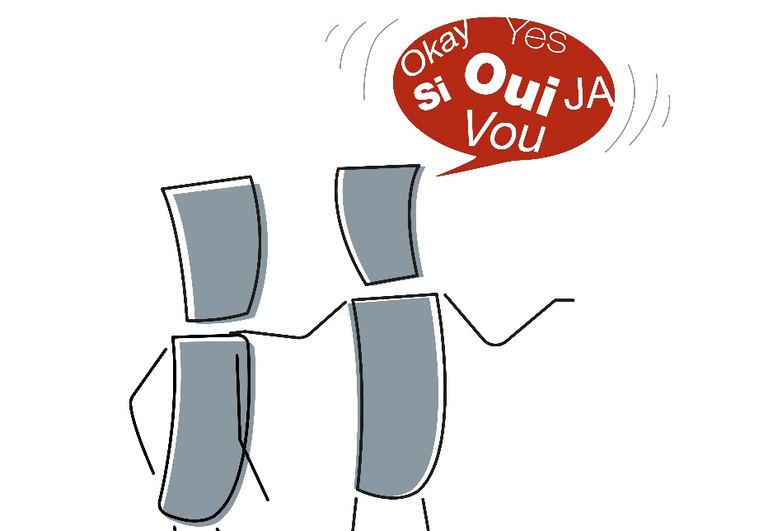
Questioning–Accommodating
How you deal with differences of opinion
Notes:
SAY:
Do you tend to ask questions to understand and solve problems? Would you usually prefer to have all the answers before moving forward (Questioning)?
OR
Do you tend to look for areas of agreement or compromise to encourage harmony? Would you usually let information surface naturally rather than questioning others (Accommodating)?

Slide 43
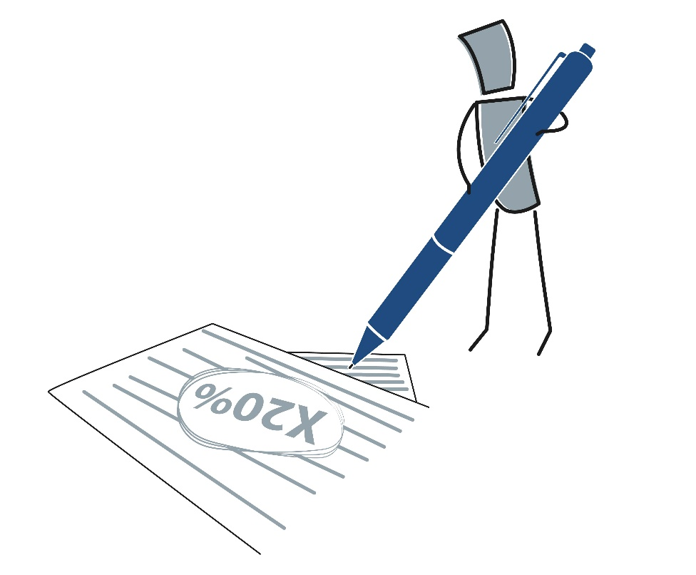

Critical–Accepting
How you communicate about disagreements
Notes:
SAY:
Do you tend to look for what’s wrong so that flaws can be corrected (Critical)?
OR
Do you tend to look for what’s right, seeing the positive in people or situations and trying to build on areas of agreement (Accepting)?

Slide 44
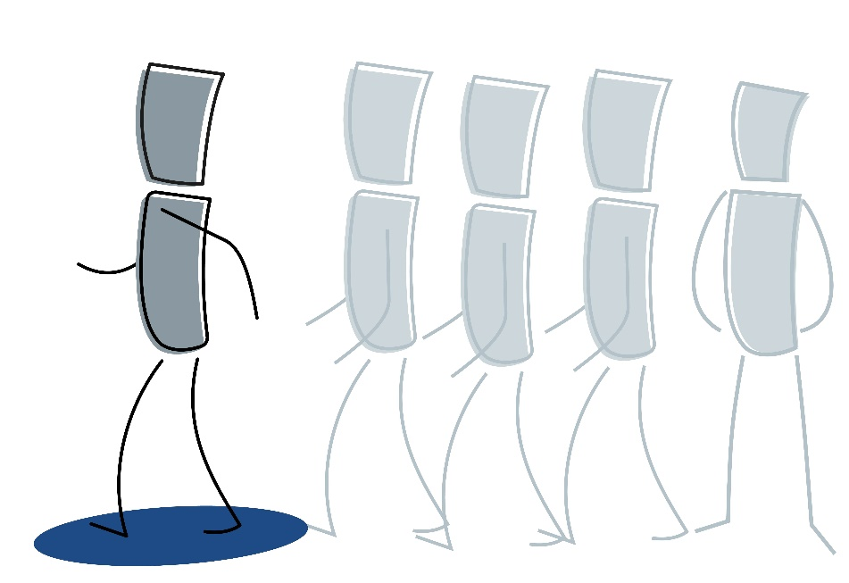

Tough–Tender
How you carry out your decisions and view the impact of decisions you’ve made
Notes:
SAY:
Do you usually focus on results and stand by your decisions, even if they prove unpopular with others (Tough)?
OR
Do you usually focus on the effects decisions have on other people and try to persuade others to understand and accept them (Tender)?
DO:
Ask participants to comment on any of their own facet results for this preference pair.

Slide 45
MBTI® Step II™ and Teams
  As a group, discuss your facet results on the next slide:
  What do these results mean for this team?
  What do you want to share regarding your own results?
  What do you want to ask others about their results?

Slide 46
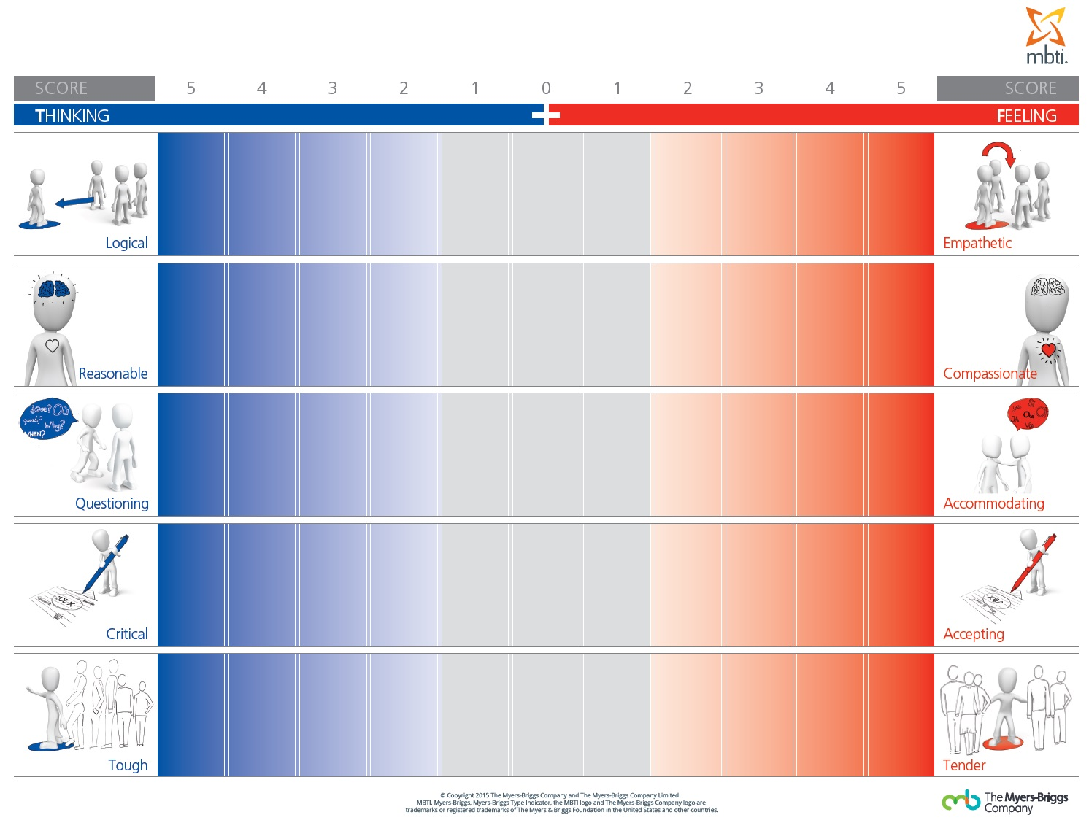
T–F Facets Team Poster
KA
NL
NZ
HB
KG
CB
KA
NL
CB
NZ*
KG
HB
KA
NL
KG
CB
HB
NZ
KA
NZ
NL
KG
CB
HB
KA
NL
NZ
CB
KG
HB
Notes:
Note: Replace initials with those of the current team. Also, the “*” symbol represents an Out-of-Preference facet result.

Slide 47
T–F Facets Team Poster
Score | 5 | 4 | 3 | 2 | 1 | 0 | 1 | 2 | 3 | 4 | 5 | Score
Logical |  |  |  |  |  |  |  |  |  |  |  | Empathetic
Reasoning |  |  |  |  |  |  |  |  |  |  |  | Compassionate
Questioning |  |  |  |  |  |  |  |  |  |  |  | Accommodating
Critical |  |  |  |  |  |  |  |  |  |  |  | Accepting
Tough |  |  |  |  |  |  |  |  |  |  |  | Tender
Thinking
Feeling
MB
MB
MB*
Notes:
Note: Replace “MB” initials with those of the current team based on their score. The “*” symbol represents an Out-of-Preference facet result.

Slide 48
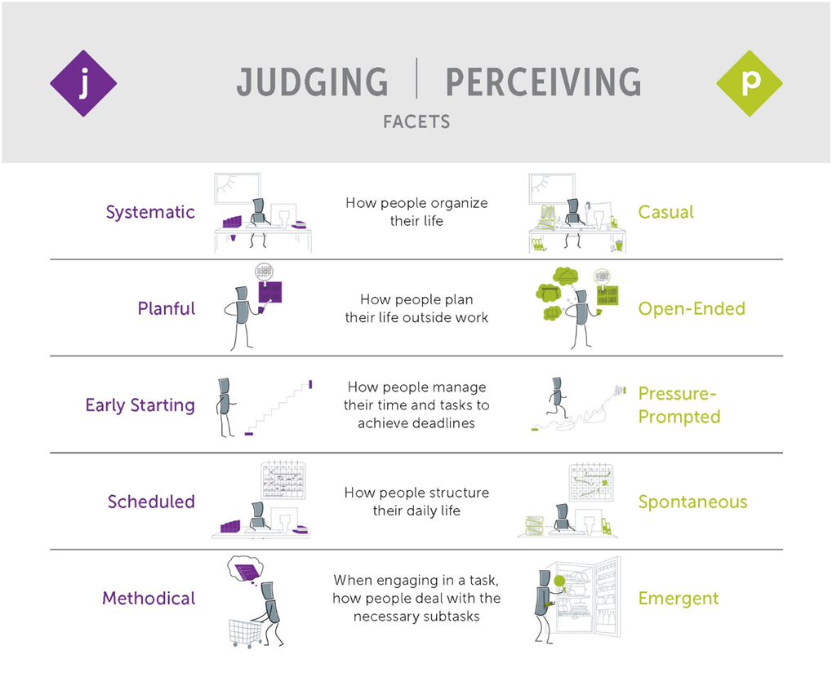
MBTI® Step II™ Interpretive Report, page 8
Notes:
(Optional, if using Feedback Card Set resource)
Say:
You have this feedback card in your Step II set. All the illustrations you’ll see in this section are on the cards.

Slide 49
Systematic–Casual activity
  You just got off the phone with a friend. They have arranged a surprise weekend away for you—this coming weekend.
  In your breakout group, discuss the following questions:
  What do you think about this news? How do you feel?
  How would you react toward the friend who arranged this surprise?
  You’ll have five minutes for your discussion.
  Be prepared to share your answers.
Midzone
Systematic
Casual
Notes:
DO:
Set up groups of participants with Systematic, Casual, and Midzone results in advance (three groups). Split up groups larger than six and have multiple groups for each category if required.
Here are some points to listen for during the debrief:
People with Systematic results tend not to like surprises. They may be frustrated by their friend’s behavior in organizing this trip without telling them.
People with Casual results will likely not have any confirmed plans for the weekend and will be happy to go. They may be excited by the surprise.
People with Midzone results may ask questions (to themselves or others) or may consider information or plans from elsewhere to help them make sense of the situation.

Slide 50
Early Starting–Pressure Prompted Activity
  What do you like about your facet result? When might it not work for you?
  What are challenges when working with people on the opposite side of the facet?
  Midzone group: What are challenges when working with people on either side of the facet?
  You’ll have five minutes for your discussion.
  Be prepared to share your answers.
Midzone
Early Starting
Pressure Prompted
Notes:
*You can use either this activity or the following slide if you do not have time for both.
DO:
Set up groups of participants with Early Starting, Pressure Prompted, and Midzone results in advance (three groups). Split up groups with more than six people and have multiple groups for each category if required.

Slide 51


Systematic–Casual
How you organize your life in general
Notes:
SAY:
Do you like order and structure in your life? Do you prefer to be prepared for any eventuality, so you won’t be taken by surprise (Systematic)?
OR
Do you tend to feel constrained by structure and rules, preferring to stay open to experiences, surprises, and change (Casual)?

Slide 52
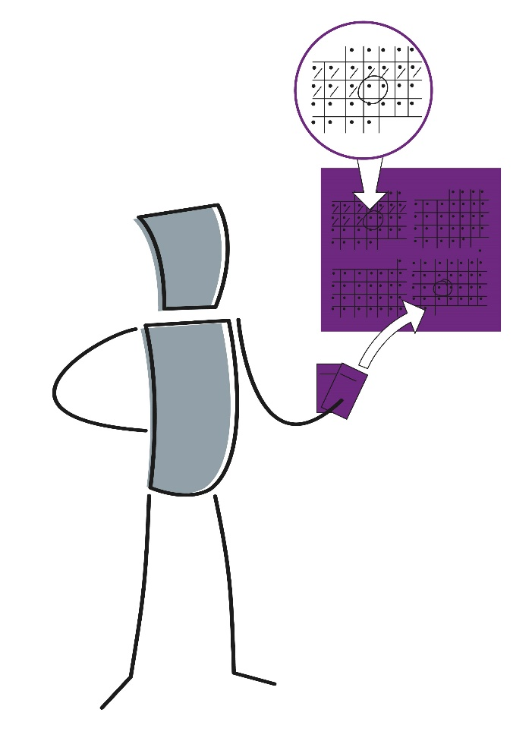
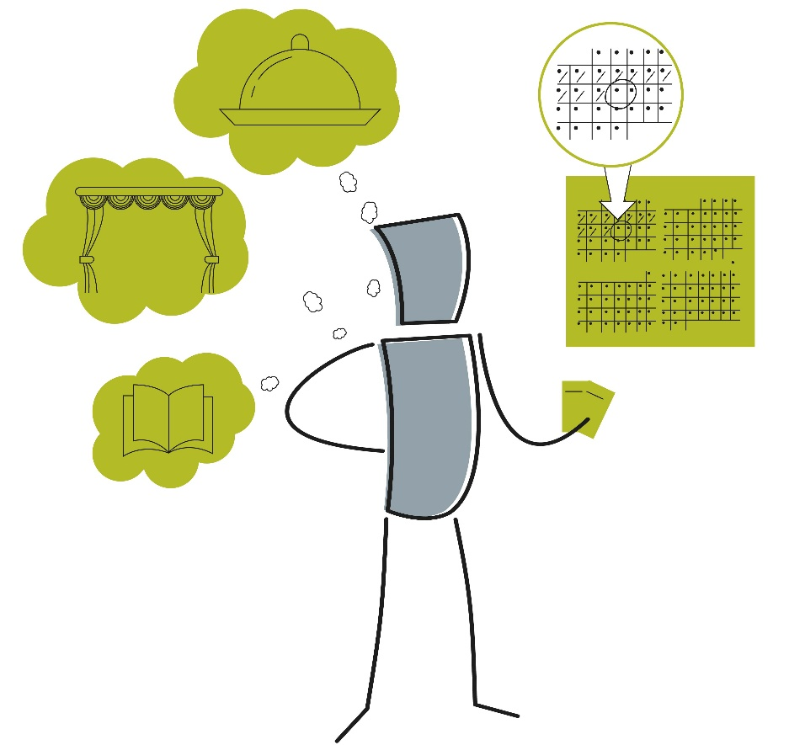
Planful–Open-Ended
How you plan for future events and set goals
Notes:
SAY:
Does planning activities in advance help you relax and enjoy your experiences (Planful)?
OR
Do you prefer to be able to respond spontaneously to opportunities as they arise, changing or adapting your plans and making decisions quickly in the moment (Open-Ended)?

Slide 53
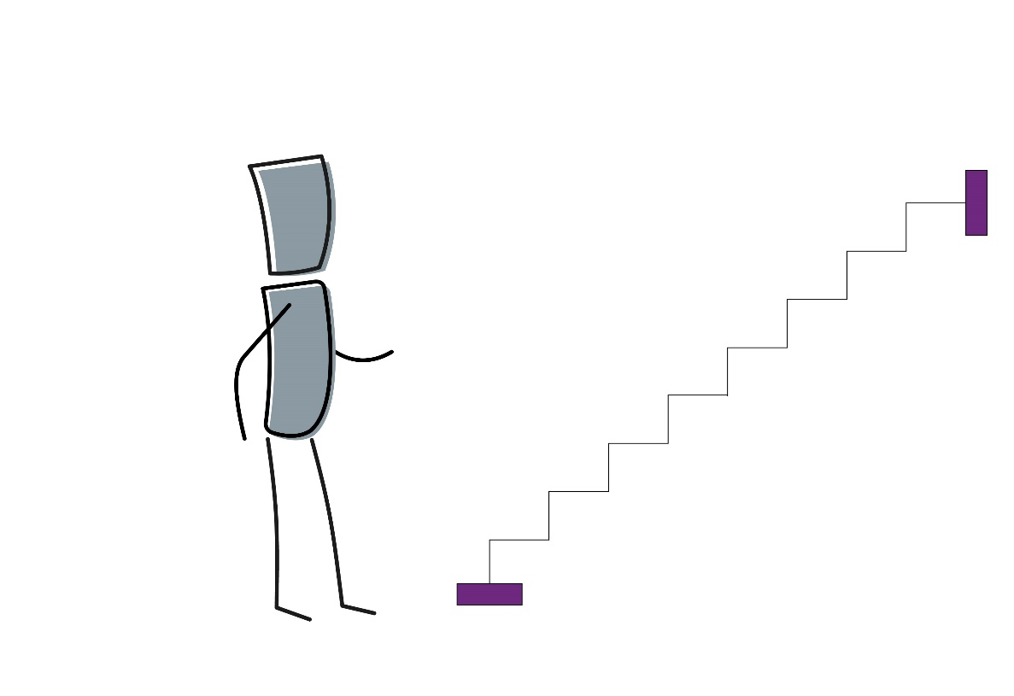
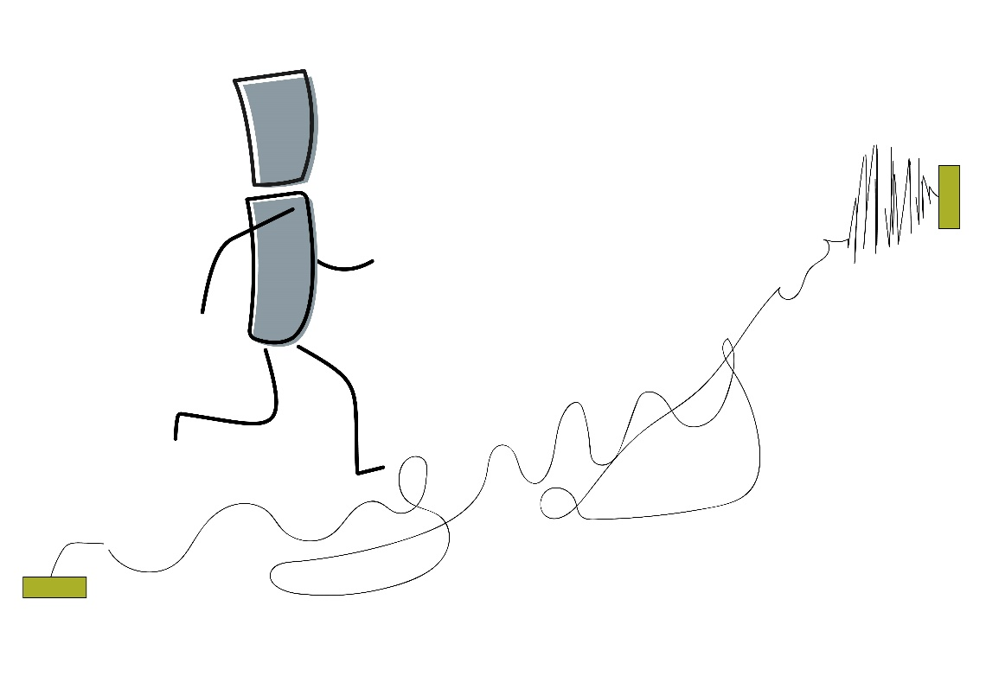
Early Starting–Pressure-Prompted
How you manage your time and approach tasks to meet deadlines
Notes:
SAY:
Do you prefer to plan toward a deadline, concentrating on one task at a time and working steadily to get everything done ahead of schedule (Early Starting)?
OR
Do you prefer to plan backward from the deadline, working on several things at once and doing most of the work in a burst of energy at the last minute (Pressure-Prompted)?

Slide 54
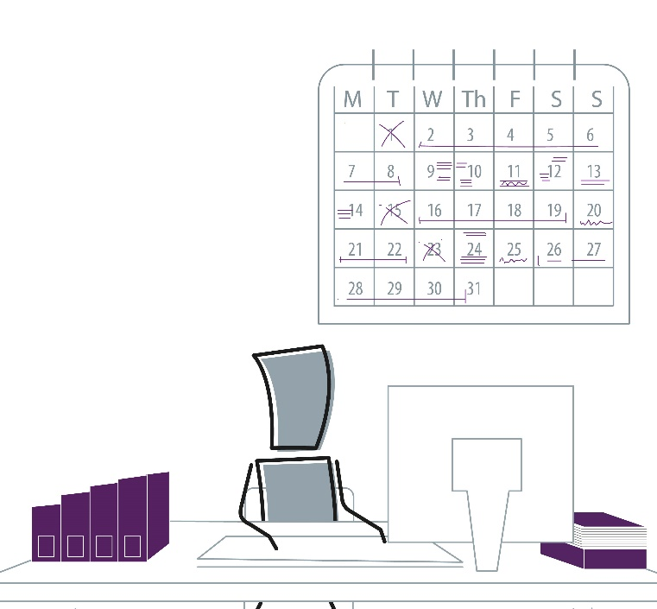
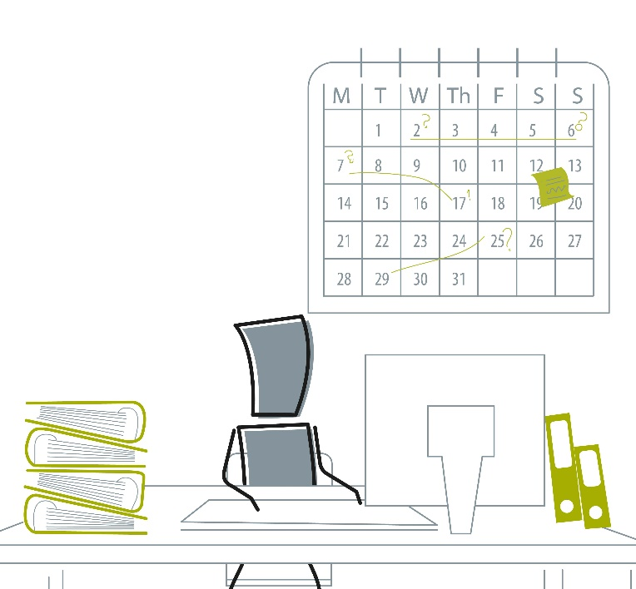
Scheduled–Spontaneous
How you structure your daily life
Notes:
SAY:
Do you usually work more effectively when you’re following a routine or process and have a predictable flow of work (Scheduled)?
OR
Do you tend to work best when you have variety and the freedom to choose what to do next (Spontaneous)?

Slide 55

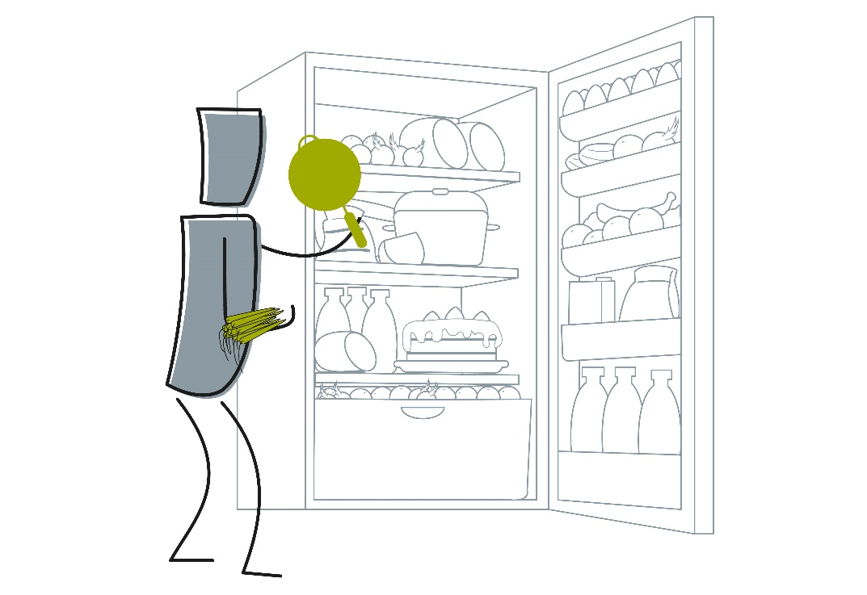
Methodical–Emergent
How you deal with the subtasks required to get something done
Notes:
SAY:
Do you like to organize yourself and any materials before starting work on a task? Do you usually plan, make lists, and read instructions before getting started (Methodical)?
OR
Do you like to move quickly into action with an outline plan and see what happens (Emergent)?
DO:
Ask participants to comment on any of their own facet results for this preference pair.

Slide 56
MBTI® Step II™ and Teams
  As a group, discuss your facet results on the next slide:
  What do these results mean for this team?
  What do you want to share regarding your own results?
  What do you want to ask others about their results?

Slide 57
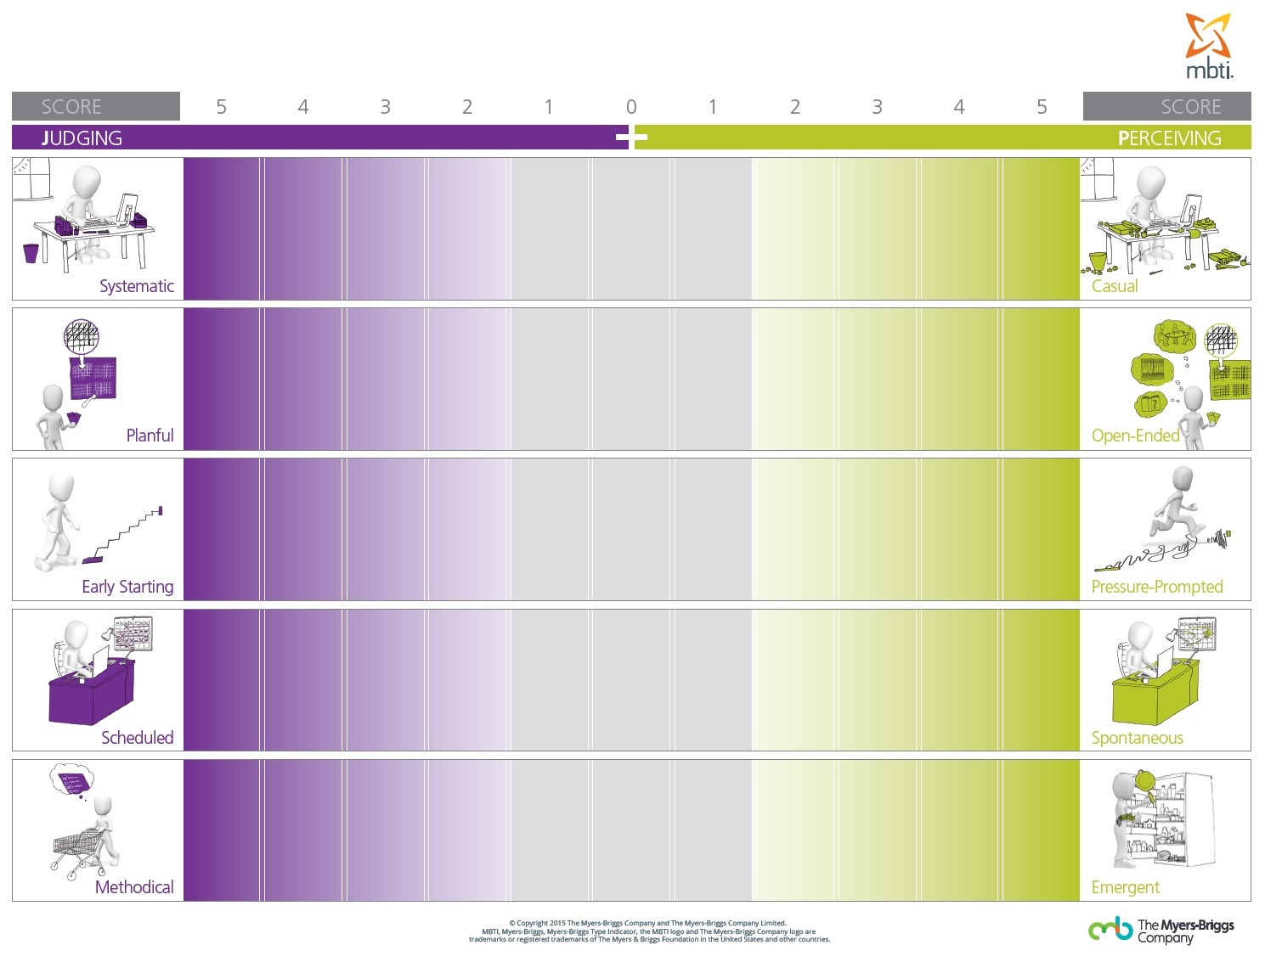
J–P Facets Team Poster
KA
HB
CB
KG
NZ
NL
KG
NZ
HB
NL
KA
CB
CB
NZ
KG
HB*
NL
KA
CB
HB
KG
NL
KA
NZ
NZ
HB
KG*
NL
KA
CB
Notes:
Note: Replace initials with those of the current team. Also, the “*” symbol represents an Out-of-Preference facet result.

Slide 58
J–P Facets Team Poster
Score | 5 | 4 | 3 | 2 | 1 | 0 | 1 | 2 | 3 | 4 | 5 | Score
Systematic |  |  |  |  |  |  |  |  |  |  |  | Casual
Planful |  |  |  |  |  |  |  |  |  |  |  | Open-ended
Early Starting |  |  |  |  |  |  |  |  |  |  |  | Pressure Prompted
Scheduled |  |  |  |  |  |  |  |  |  |  |  | Spontaneous
Methodical |  |  |  |  |  |  |  |  |  |  |  | Emergent
Thinking
Feeling
MB
MB
MB*
Notes:
Note: Replace “MB” initials with those of the current team based on their score. The “*” symbol represents an Out-of-Preference facet result.

Slide 59

Exploring the MBTI® Step II™ Interpretive Report
Notes:
The following slides can be used for participants wanting a deeper dive into the Step II™ Interpretive Report Results.

Slide 60
MBTI® Step II™ Interpretive Report
Step I™ results (page 3)
Step II™ facet profiles (pages 5 to 8)
Applications (pages 9 to 12)
Type dynamics (pages 13 and 14)
Integrating Step I and Step II (page 15)
Results overview (page 16)
Interpreter’s summary (page 17)
Let’s explore some of these sections in more detail.
Notes:
Applications include:
Communicating
Making decisions
Managing change
Managing conflict

Slide 61
Facet Profiles and Descriptions
Facet profiles (pages 5 to 8):
  Four charts of facet results grouped by Step I™ preference pair
  Text descriptors for each facet, outlining how you are likely to experience or express that facet based on both your facet result and your Step I preference
  This means that there are six possible descriptions for each facet.
Notes:
Suggested script: We looked at definitions of the 20 Step II facets this morning. You will also have explored some behavioral differences based on the three Step II score categories—In-Preference, Midzone, and Out-of-Preference.
On pages 5 to 8 of your “MBTI® Global Step II™ Interpretive Report,” you’ll see your own facet profiles, organized by Step I preference pair. You’ll also see text descriptors for each of your facet results.
These descriptors outline how someone is likely to experience or express that facet, based on both their facet result and their overall Step I preference. This means that there are six possible sets of descriptors for each facet—one set each for In-Preference, Midzone, and Out-of-Preference results toward each facet pole.
Let’s look at the first Extraversion–Introversion facet, Initiating–Receiving, as an example.

Slide 62
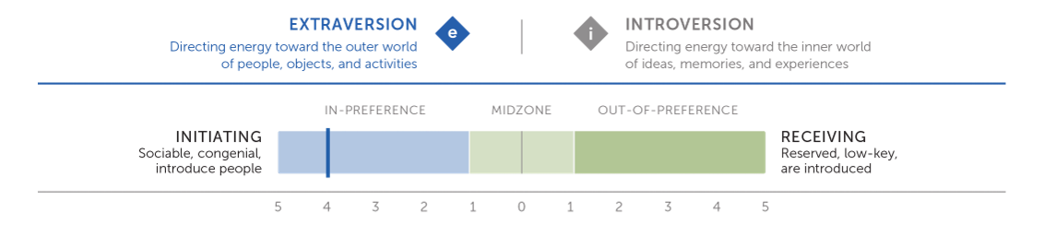
In-Preference Initiating
  Are assertively outgoing in social situations
  Carry out social obligations with finesse, readily introducing people to each other
  Enjoy linking people whose interests are similar
  Act as a facilitator in social situations
  Genuinely want people to interact and get to know each other
  Are comfortable talking to just about anyone
Notes:
DO:
Invite participants with In-Preference Initiating to share what resonates with them in this description and discuss any thoughts of their own.

Slide 63
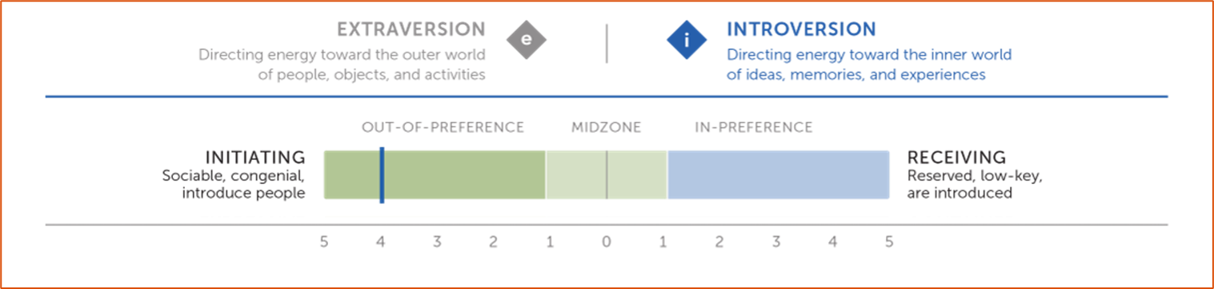
Out-of-Preference Initiating
  Play the social initiator role when circumstances require it
  Focus on putting others at ease with each other and with you
  Are comfortable initiating in a small group or when the people are interesting to you
  Take the lead when you know people in the group or know the topic well
Notes:
DO:
Invite participants with Out-of-Preference Initiating to share what resonates with them in this description and discuss any thoughts of their own.

Slide 64
Midzone Initiating–Receiving
  Extraversion preference
  Will initiate conversations in social situations with people you already know or if your role calls for it
  Are at ease socially in familiar situations, but less at ease in large social gatherings
  Are comfortable talking to strangers at large gatherings when there is a shared interest
  Are willing to introduce people to each other if no one else does so and introductions are necessary
  Whether you initiate or receive depends on how much socializing or alone time you’ve experienced that day
Notes:
DO:
Invite participants to highlight differences and similarities in the descriptions of Extroversion and Introversion Midzone preferences.

Slide 65
Midzone Initiating–Receiving
  Introversion preference
  Are at ease socially in familiar situations, but much less so in large social gatherings
  Find that your comfort with introductions increases with practice
  Are somewhat uncomfortable interacting with strangers
  Will initiate conversations in social situations with people you already know or if your role calls for this
  Are willing to introduce people to each other if no one else does, but would prefer not to
Notes:
DO:
Invite participants to highlight differences and similarities in the descriptions of Extroversion and Introversion Midzone preferences.

Slide 66
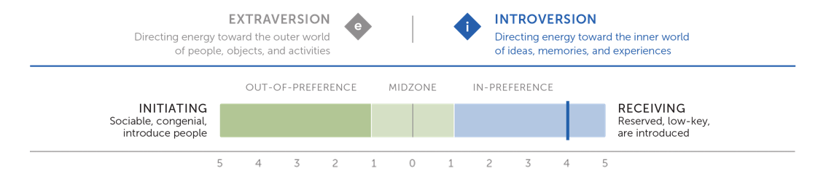
In-Preference Receiving
  Find social duties uncomfortable and leave them to others
  Prefer in-depth discussion about important issues; hate small talk
  Believe it is intrusive to set people up socially; don’t want others to set you up either
  May be seen by others as quiet, shy, or detached
  Have difficulty keeping up a conversation when there are no shared interests
  Find intrusions such as phone calls to be unwelcome interruptions; when making calls or otherwise initiating contact, prefer to do it alone
Notes:
DO:
Invite participants with In-Preference Receiving to share what resonates with them in this description and discuss any thoughts of their own.

Slide 67
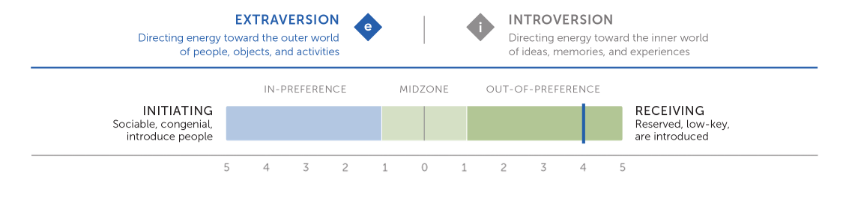
Out-of-Preference Receiving
  Prefer small rather than large social gatherings
  Are seen as reserved rather than outgoing
  May be uncomfortable initiating social contacts
  Tend to focus on a few people at large affairs rather than to circulate
  Let others take the lead in introducing people to each other
  Those familiar with your usual outgoing nature may be puzzled by your reluctance to make introductions.
Notes:
DO:
Invite participants with Out-of-Preference Receiving to share what resonates with them in this description and discuss any thoughts of their own.

Slide 68

Action Plan
Wrap-up

Slide 69
Action Planning
After reading about your type and preferences, use the following questions to consider your learning and development:
What have you learned from exploring your Step II™ results?
What are your biggest takeaways from the session today?
How can you make use of your strengths in the best way?
How might others see you?
Are there any areas you would like to develop?
What questions are coming up for you around your Step II™ facets?
What specific action steps do you want to take moving forward?
Notes:
DO:
Ask participants to reflect on these questions and update how they’d share that information based on how you conclude this workshop.

Slide 70
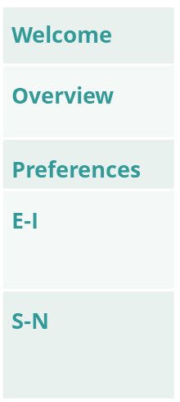
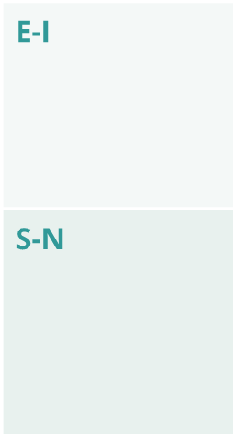
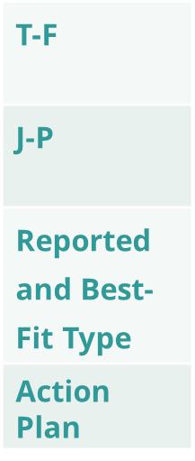
Facilitator Notes for In-Person Workshop
Establish psychological safety early.
Warmly greet participants; create a comfortable seating arrangement with small groups at tables.
Incorporate larger team table or poster.
Before the session have a large team table or poster which people can add their names to throughout.
Facets
Guide participants through animated slides on the facets making activities interactive.
Write on flipchart as participants share real-life examples of how preferences show up in behavior.
Facilitate open “breakout” discussion in same type (initiating / receiving) pairs or trios.
Encourage dialogue in designated physical spaces (tables, classroom corners, breakout rooms).
Use physical versus digital visual aids to “show a picture” for realistic / imaginative.
Display photos and S-N type tables in large print, use flip charts for group mapping.
Manage confidentiality and comfort during logical / empathetic activity.
Arrange seating (tables, classroom corners, breakout rooms) for privacy during personal sharing.
Demonstrate preference dichotomies during the systematic / casual activity debrief.
Use physical “line-up” along a line on the floor (versus virtual markers) to illustrate differences (J-P).
Best-Fit Type
Support best-fit type verification.
Offer paper summaries to help participants reflect and mark their verified type.
Action Plan
End with connection and action planning.
Close with a circle discussion and/or written takeaway cards on applying type to work relationships.
Notes:
HIDDEN SLIDE

